Slide 1




Year 2 Reading writing workshop
26th September 2024
Mr Dickenson

Slide 2
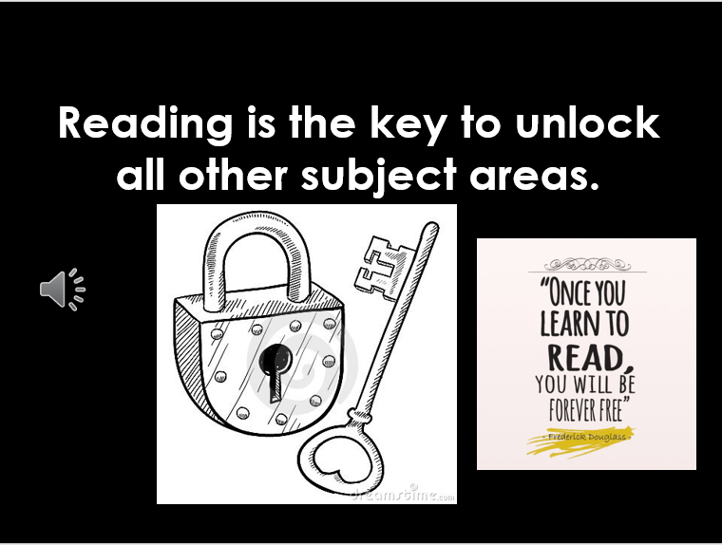

Slide 3

Reading and spelling

Slide 4
How do we teach reading in books?
Reading practice sessions are:
timetabled twice / three times a week
taught by a trained teacher/teaching assistant
taught in small groups.
Notes:
The children read the same book twice in a week. The first time we work on decoding (sounding out) the words, the second time we work on prosody which is reading with expression – making the book sound more interesting with our story-teller voice or our David Attenborough voice – and the third time we look at comprehension. We read the books three times at school because we want to develop the fluency. The more they see words the more they begin to read them automatically without having to sound them out.

Slide 5
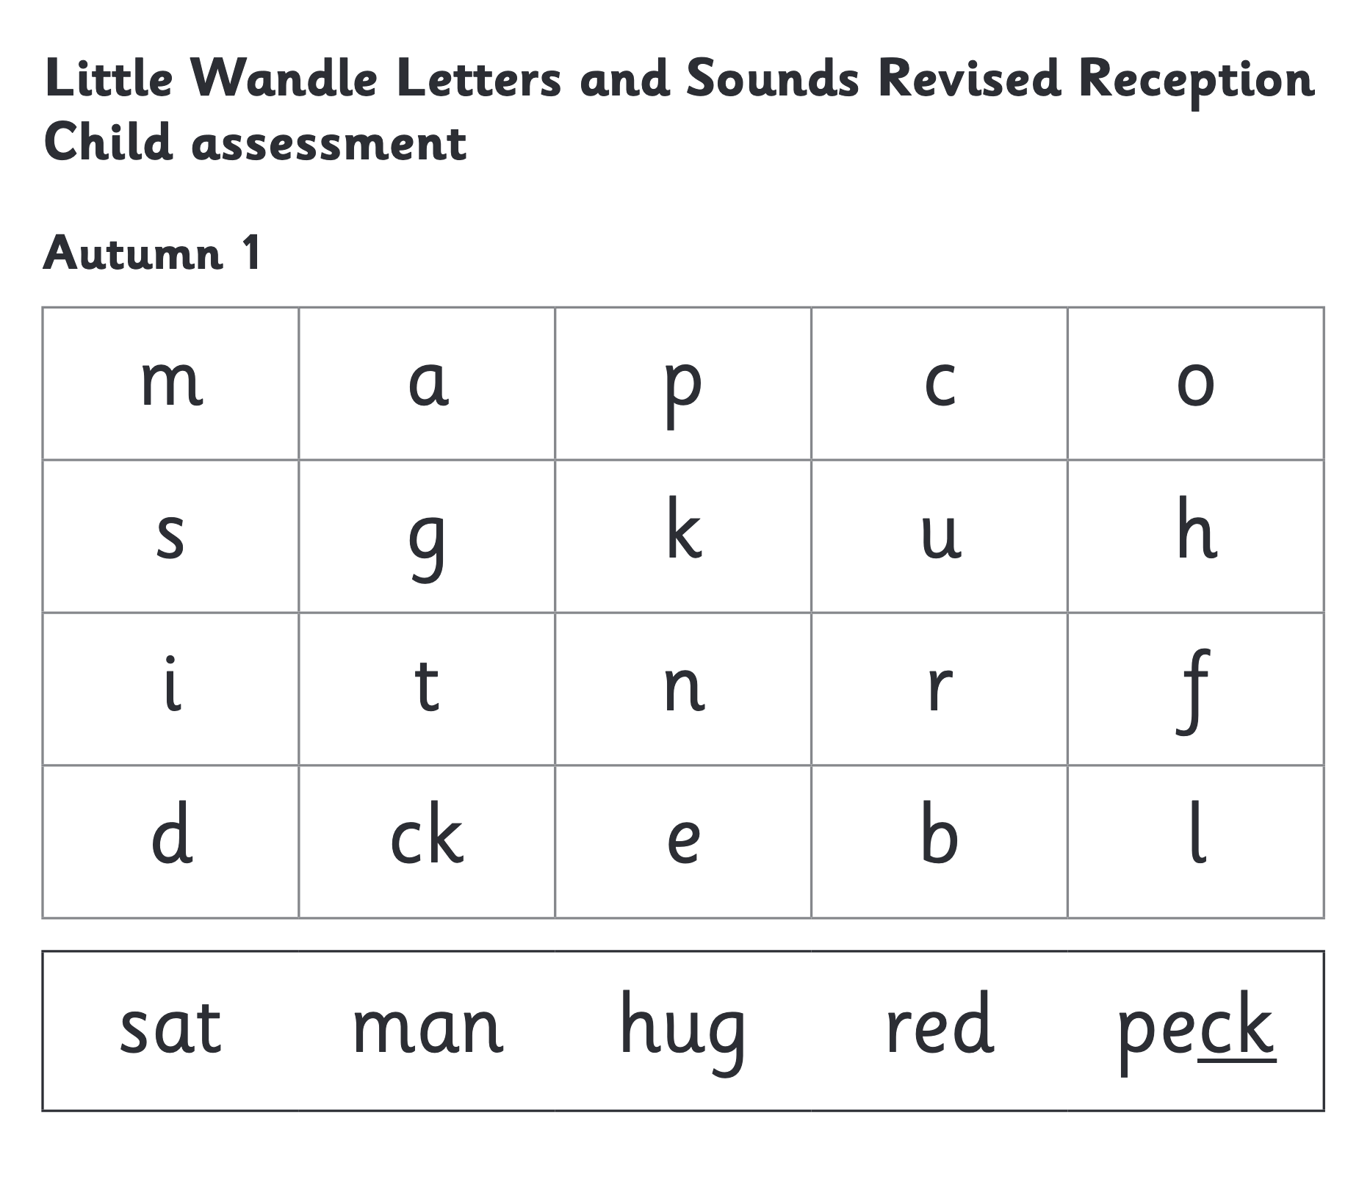
We use assessment to match your child the right level of book
Notes:
We assess your child every six weeks to check progress. Any child who needs extra support has daily keep-up sessions planned for them.

Slide 6
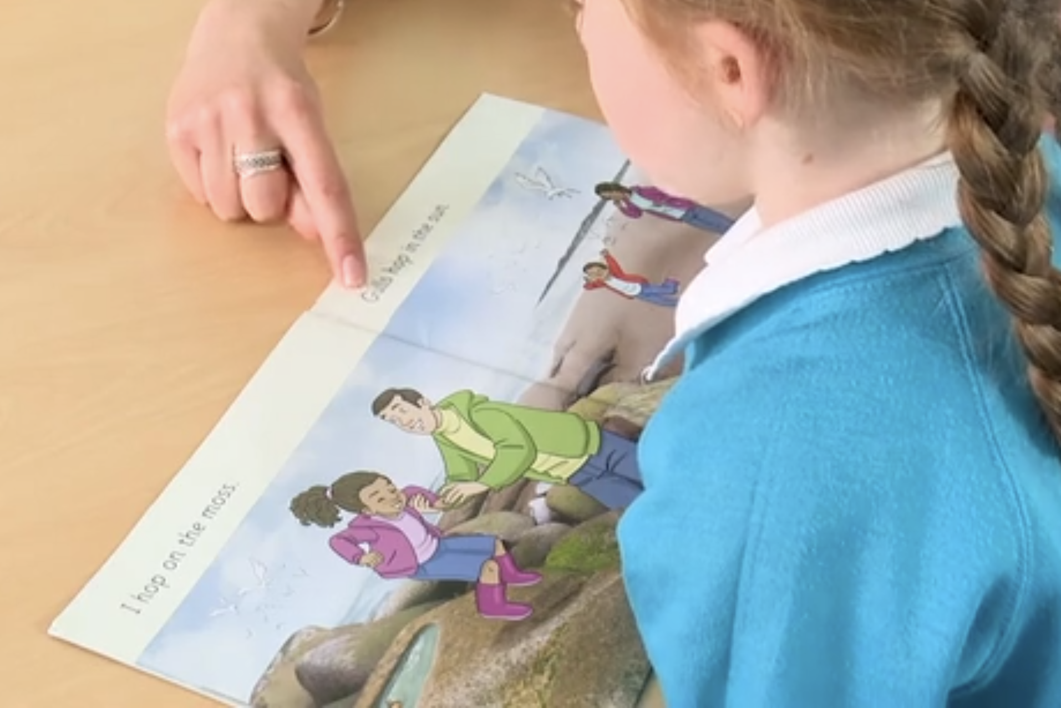
Reading a book at the right level
This means that your child should:
Know all the sounds and tricky words in their phonics book well
Read many of the words by silent blending (in their head) – their reading will be automatic
Only need to stop and sound out about 5% of the words by the time they bring the book home – but they should be able to do this on their own.

Slide 7
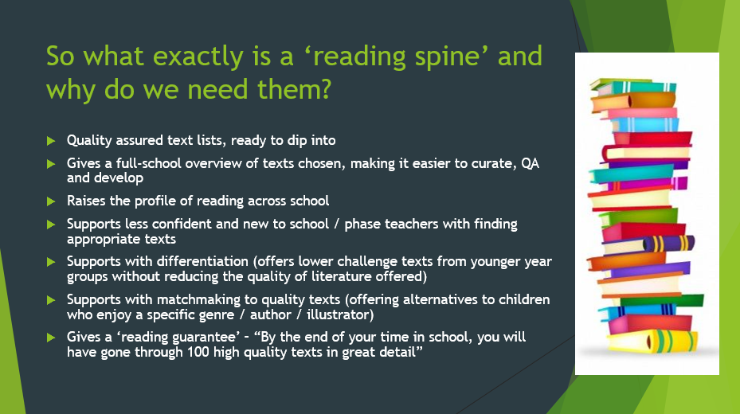

Slide 8
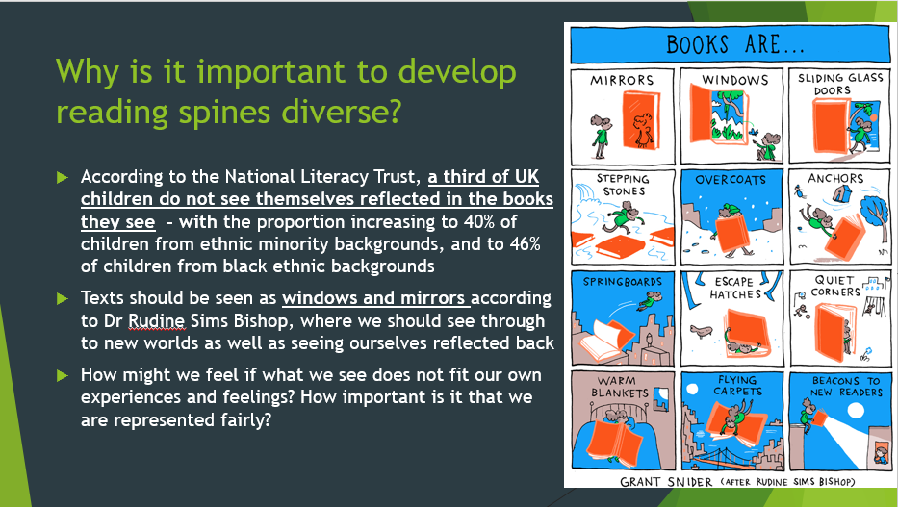

Slide 9

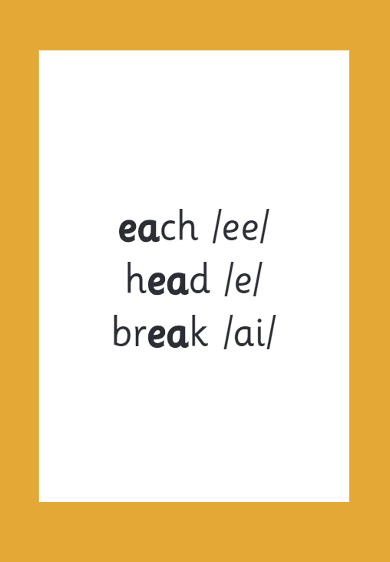
Reading and spelling
Notes:
This is an example of what the children learn in Year 1.
Children learn that there are graphemes that can have different sounds and sounds that can be made with different letters.
Use the backs and fronts of Phase 5 cards to show ‘ea’ and ‘ow’.

Slide 10
And all the different ways to write the phoneme sh:
shell
chef
special
caption
mansion
passion

Slide 11

Spelling
Say the word.
Segment the sounds.
Count the sounds.
Write them down.
Notes:
Model the process on a flipchart for the parents to see.

Slide 12


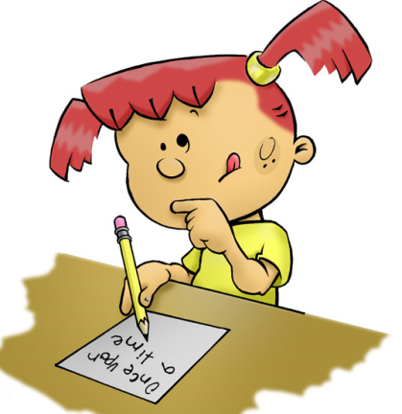
How is writing taught in Year 2?
Inviting authors, poets, illustrators, playwrights etc. into school
Little Wandle Phonics
(Year 1 and 2) and Spelling (Year 2)
(25/30 mins daily)
Writing journeys – using rich text
(40-50 mins daily)
Interventions
Handwriting – daily
Cross-Curricular – through topic
Notes:
2 mins
English learning happens all of teh time as it is in everything!
English lesson- variety of structures: whiteboard work, partner, independent, group, shared writing, teacher modelling, sometimes linked to topic, different stimuli

Slide 13
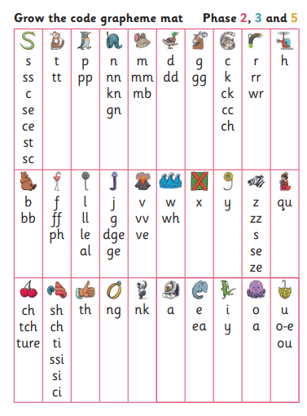
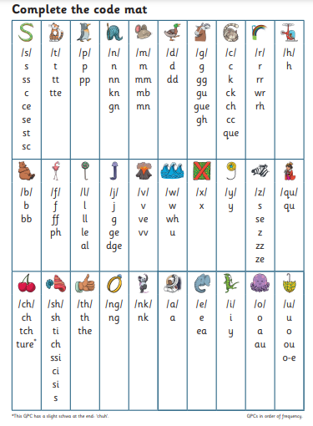
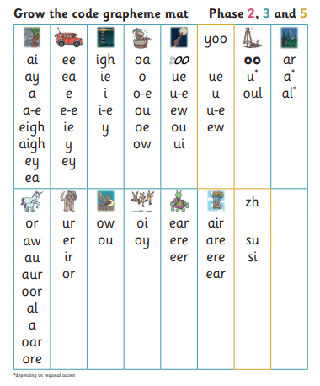
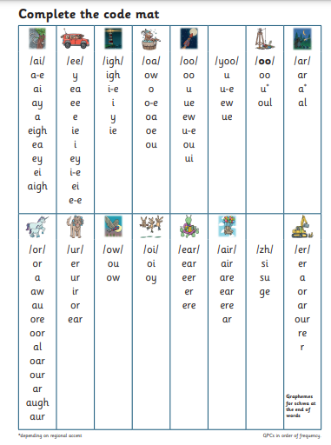
How is writing taught in Year 2?
Spelling with confidence – Best bet.

Slide 14
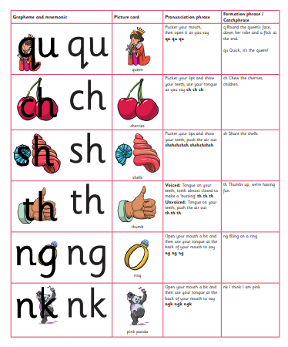
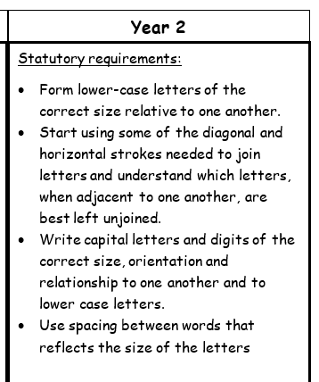
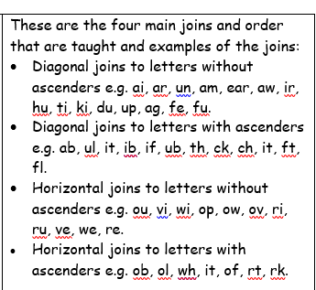
Handwriting

Slide 15
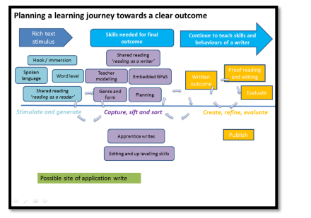

How is writing taught in KS1?

Slide 16


What we teach in year 2
commas for list
subordination, coordination,
expanded noun phrases
apostrophes for contractions and possession,
Sentence types: statement, question, exclamation, command
compound words
suffixes- ness –er, -ful, -less –est, -ly
present/past, progressive form of verbs,
Notes:
2 mins
Consolidating all of year 1 and….. BUT we still make it fun and interesting with purpose and different text types.

Slide 17

Word classes
Noun-
Verb-
Adjective-
Adverb-
A person, place or thing
A doing word
A describing word (describes the noun)
Describes how the “doing” was done.
Find the nouns, verbs and adjectives in the sentences:
Jack tiptoed nervously through the narrow hallway.
The cute baby giggled loudly as the dog wagged its fluffy tail.
Notes:
7 mins Good if you can use terminology at home
Quick games eg act out the adverb (pass the potato quickly, slowly, angrily, carefully etc along the line)
Verb- human puppet (willing parent or use Grace)
Adjective- describe the man in picture (personality and appearance)
Task of finding the word classes in sentences

Slide 18
Word classes
Noun-
Verb-
Adjective-
Adverb-
A person, place or thing
A doing word
A describing word (describes the noun)
Describes how the “doing” was done.
Find the nouns, verbs and adjectives in the sentences:
Jack tiptoed nervously through the narrow hallway.
The cute baby giggled loudly as the dog wagged its fluffy tail.
Notes:
7 mins Good if you can use terminology at home
Quick games eg act out the adverb (pass the potato quickly, slowly, angrily, carefully etc along the line)
Verb- human puppet (willing parent or use Grace)
Adjective- describe the man in picture (personality and appearance)
Task of finding the word classes in sentences

Slide 19
Punctuation
Full stops- to show the end of a sentence/statement.
Capital Letter – beginning of sentences, names, places
Tim is best friends with Sam.
Kate lives in London.
Question marks- when a question is asked.
Can you help please?
Do you have a spare pen?
Exclamation marks
How beautiful the sky is!
What an exciting journey that was!
Notes:
2 mins Technique- think it, say it, write it for writing sentences.
Using vocab- proper noun, pronoun
This punctuation links to sentence types

Slide 20
Sentence Types
Exclamatory – begins with a what or a how, contains a verb and a noun, end with !
What an exciting adventure that was!
How handsome the prince looks!
Commands – bossy sentences, imperative verbs
Don’t eat the sweets!
Cut the shape out.
Questions – Asks something, ends in a question mark
Can I come too?
What colour is the sky?
Statement – gives information, ends in a full stop
The bird has grey feathers.
Jack and Jill fell down the hill.
Notes:
3 mins Ch add correct punctuation to sentences by recognising type of sentence

Slide 21
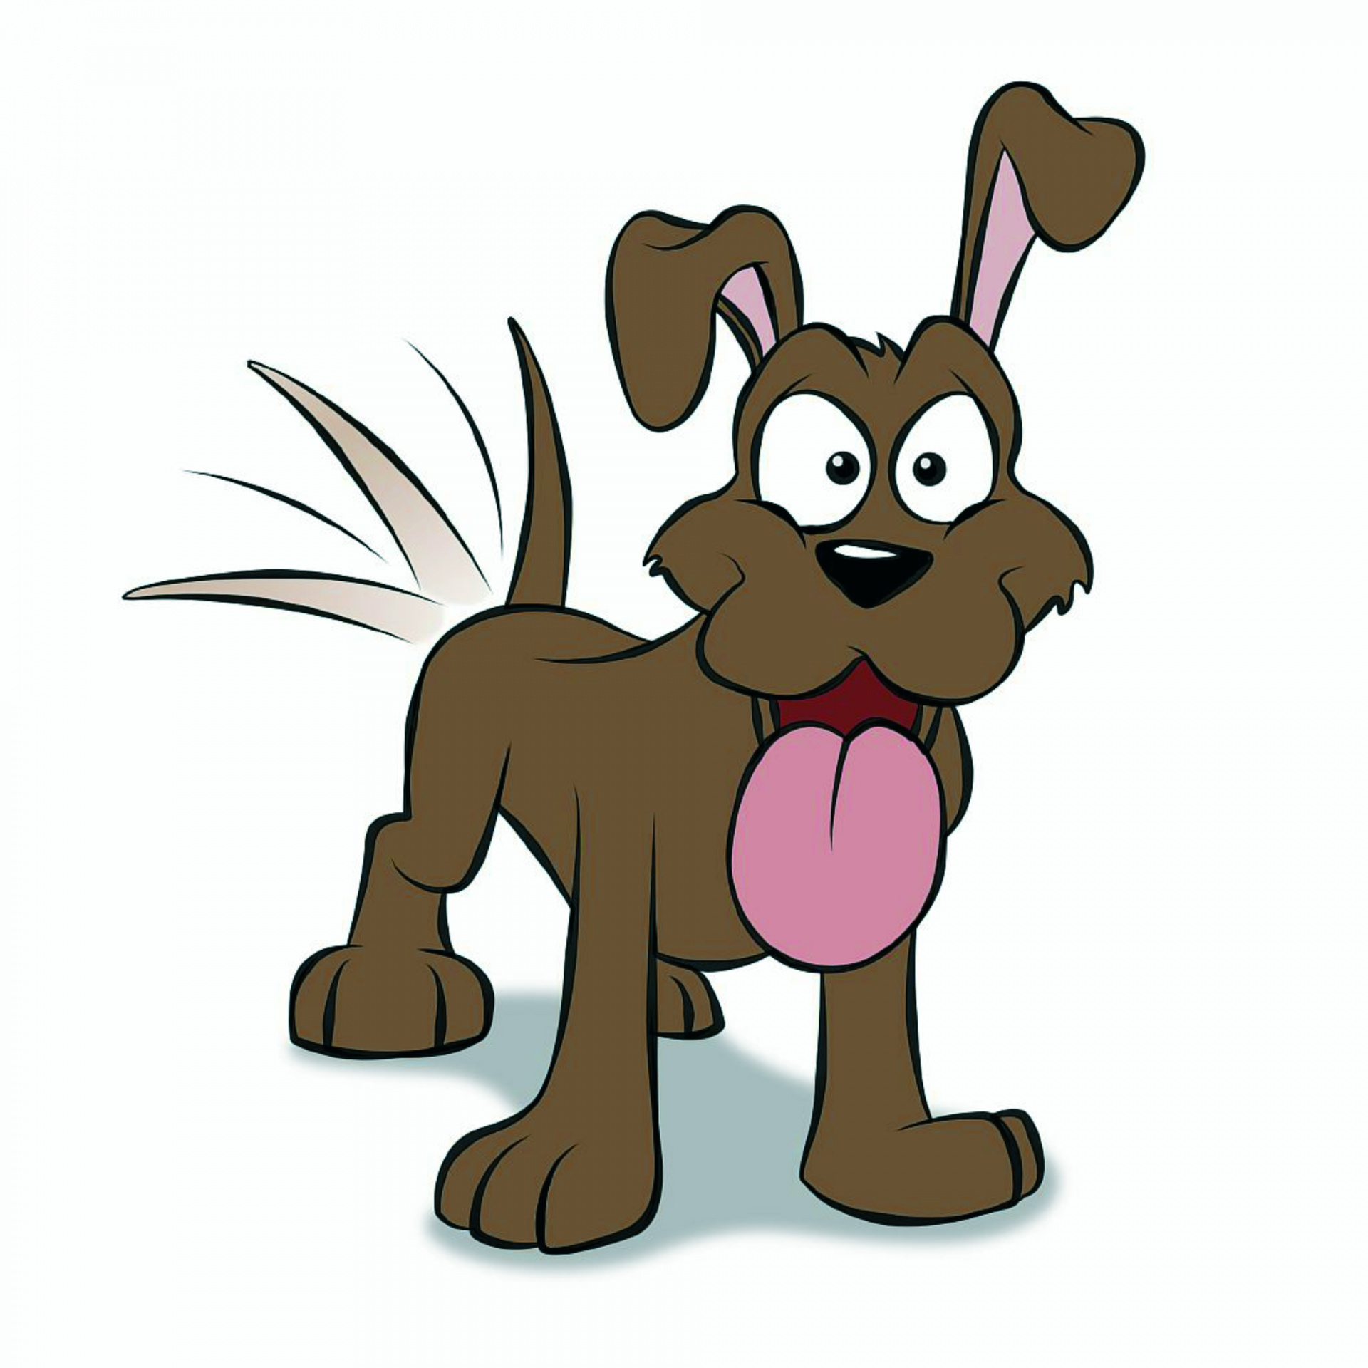
Punctuation continued
Apostrophes for possession and contractions
Dad’s socks are smelly.
I sat on my sister’s chair.
The dogs’ tails were fluffy.
I will- I’ll
Would not- wouldn’t
Notes:
5 mins Stand up if correct, sit down if wrong- audience involved

Slide 22

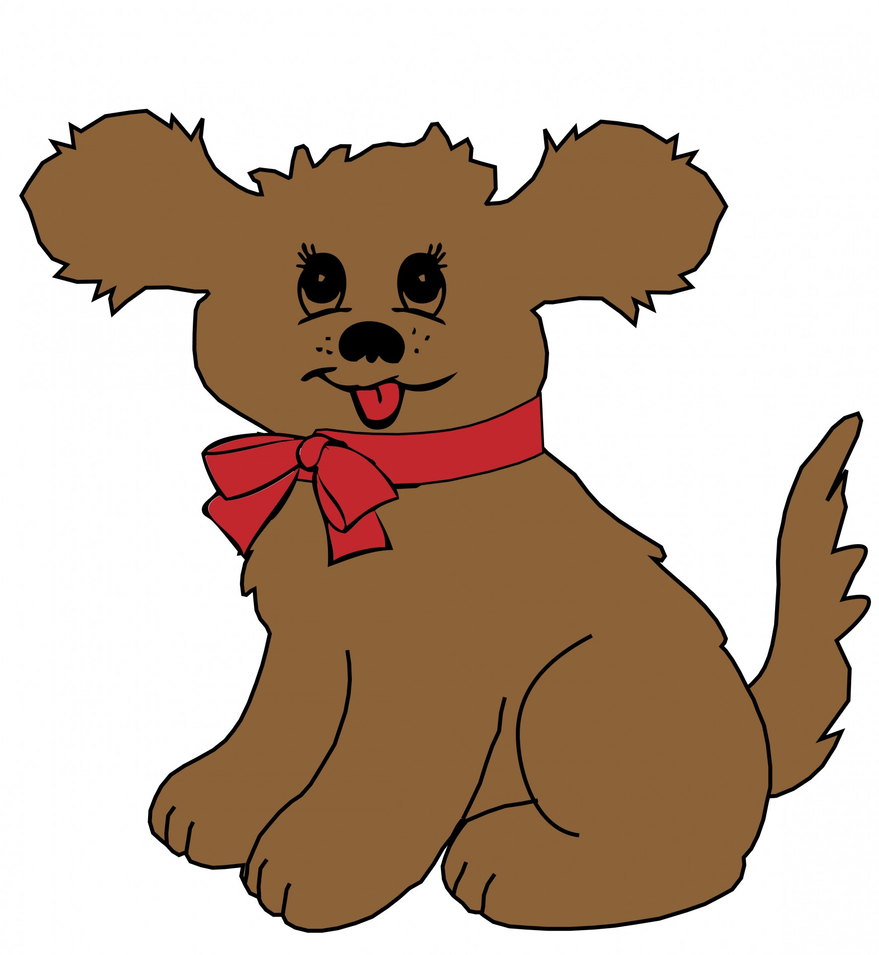

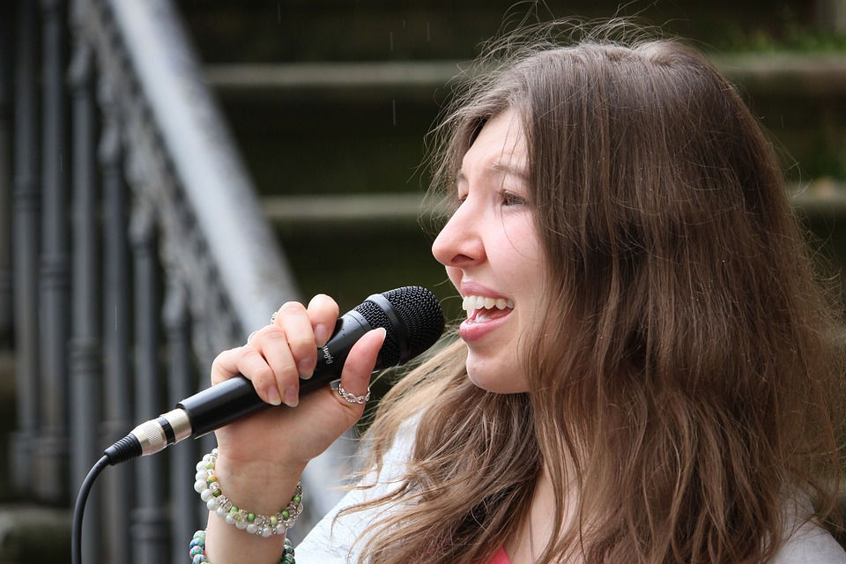
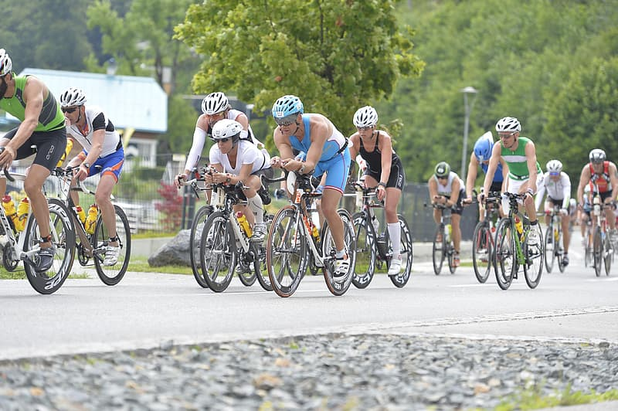
Punctuation continued
Commas- to separate items in a list.
I enjoy reading, singing and cycling.
The tiny, fluffy dog sniffed the flowers.
Notes:
1 min Action for comma- helps support children

Slide 23

Co-ordinating and subordinating connectives.
Co-ordinating conjunctions join two or more items of equal importance AND ARE OFTEN IN THE MIDDLE:
And : The children play tennis and they go to the park.
But: They can climb but they can’t swim.
Or: You can have mashed potato or you can have chips .
So: They got the highest score so they won the match.
Subordinating connectives (often introducing a subordinate clause that usually only makes sense next to the main clause)
When: We put our coats on when it rains.
If: I’ll help you if you like.
Because: I’m sad because it hurt.
That: I’d like a cake that has sparkles.
Notes:
5 mins
A lot of learning happens through teacher feedback- marking and verbal (symbols).
Make sentences using whiteboards- choose correct conjunction (use parents)

Slide 24
Tenses
Present | Past | Past progressive | Present progressive
He jumps. | We jumped. | They were jumping. | He is jumping.
I sleep. | They slept. | She was sleeping. | He is sleeping.
She paints. | You painted. | I was painting. | They are painting.
Notes:
2 mins Teach by comparison, acting, completng tables like this, lots of talking, reading and shared writing

Slide 25
Suffixes
Verb root word | -ing | -ed | -er
Hunt | hunting | hunted | hunter
jump | jumping | jumped | jumper
sit | sitting | sat | sitter
hike | hiking | hiked | hiker
Adjective root word | -er | -est
loud | louder | loudest
hot | hotter | hottest
happy | happier | happiest
nice | nicer | nicest
Notes:
2 mins Provide root words and suffixes to see which new words you can create
Mini tasks for early morning work, beginning of english lesson, during spelling session etc etc- repeat, repeat, repeat!

Slide 26
Suffixes cont’d
root word | -ment | -less | -ful | -ness | -ly
hope
enjoy
happy
cry | cries
carry | carries
Notes:
2 mins Can give ch a table like this to fill in.

Slide 27
Suffixes cont’d
root word | -ment | -less | -ful | -ness | -ly
hope |  | hopeless | hopeful
enjoy | enjoyment
happy |  |  |  | happiness | happily
cry | cries
carry | carries
Notes:
2 mins Can give ch a table like this to fill in.

Slide 28
Prefixes
root word | Un-
Happy | unhappy
lock | unlock
fair | unfair
Notes:
1 min
Saying opposite sentences with acting eg I am very happy vs I am very unhappy. etc

Slide 29
Expected standard for the
end of year 2
• write simple, coherent narratives about personal experiences and those of others (real or fictional)
• write about real events, recording these simply and clearly
• demarcate most sentences in their writing with capital letters and full stops, and use question marks correctly when required
• use present and past tense mostly correctly and consistently
• use co-ordination (e.g. or / and / but) and some subordination (e.g. when / if / that / because) to join clauses
• segment spoken words into phonemes and represent these by graphemes, spelling many of these words correctly and making phonically-plausible attempts at others
• spell many common exception words*
• form capital letters and digits of the correct size, orientation and relationship to one another and to lower-case letters
• use spacing between words that reflects the size of the letters.
Notes:
10-15 mins inc review
What the framework says. Look at samples of year 1 and year 2 work.

Slide 30

So, how can I support my child at home?
Use any opportunity to write for a purpose – Shopping list, birthday card etc.
When you are writing/typing/texting, ask your child to help you to remember which punctuation to use or how to spell etc.
Lots of opportunities for writing:
Post-it-notes
Notepad
whiteboard
Appealing pens
Ask your child to correct your writing for you (made up writing).
Spot the …. games when out with your child.
Spotting punctuation or grammar features when reading.
Use adverbs when cooking.
Adjectives to describe your surroundings.
Guess the verb acting games.
Orally telling stories/sentences.
Notes:
3 mins
Short and sweet and incidental learning is best. So child feels like the expert or doesn’t feel like they are learning.

Slide 31
Reading at home

Slide 32

The most important thing you can do is read with your child
Reading a book and chatting had a positive impact a year later on children’s ability to…
understand words and sentences
use a wide range of vocabulary
develop listening comprehension skills.
The amount of books children were exposed to by age 6 was a positive predictor of their reading ability two years later.
Parental involvement in the development of children’s reading skills: A five-year longitudinal study (2002) Senechal, M. and Lefvre, J
Notes:
Celebrate child’s success at school, make time for reading at home!

Slide 33
One of the greatest gifts adults can give is to read to children
Carl Sagan

Slide 34
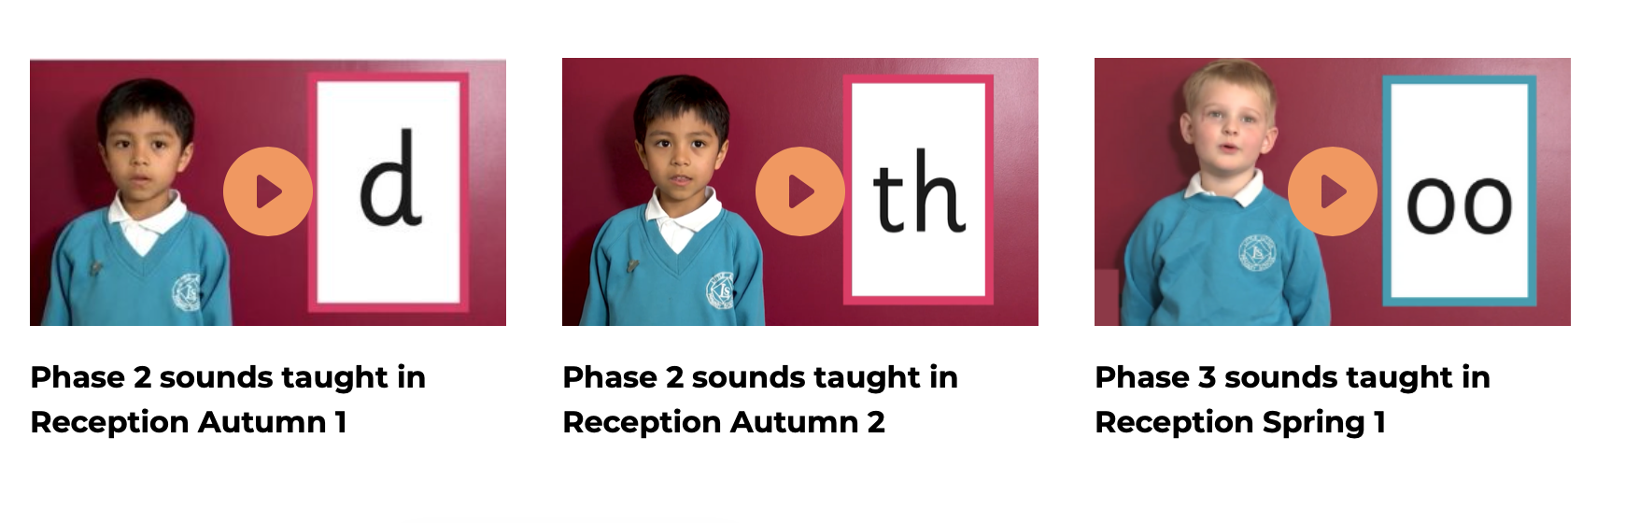
Supporting your child with phonics
Notes:
It is really important that you pronounce the sounds correctly at home if you are supporting your child. These videos are on the website for you to refer to and if you are unsure, please ask your child’s teacher.
Show the parents where to access the videos on the website and play them!
https://www.littlewandlelettersandsounds.org.uk/resources/for-parents/

Slide 35
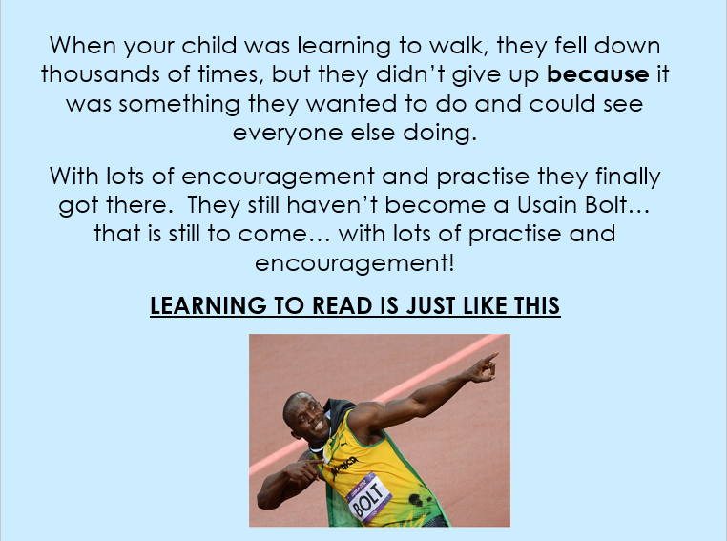
Learning to read and write is just like this!

