Slide 1




Year 1 Reading / writing workshop 12th November 2024
Mr Dickenson

Slide 2
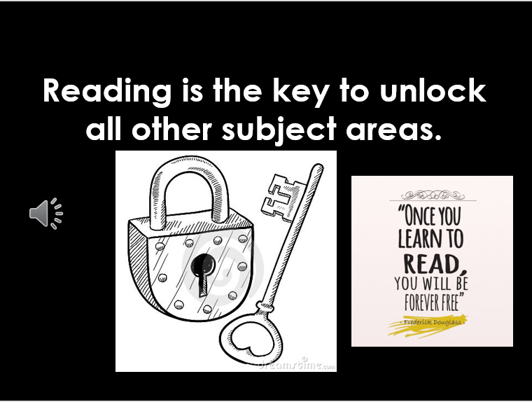

Slide 3

Reading and spelling

Slide 4
How do we teach reading in books?
Reading practice sessions are:
timetabled twice / three times a week
taught by a trained teacher/teaching assistant
taught in small groups.
Notes:
The children read the same book twice in a week. The first time we work on decoding (sounding out) the words, the second time we work on prosody which is reading with expression – making the book sound more interesting with our story-teller voice or our David Attenborough voice – and the third time we look at comprehension. We read the books three times at school because we want to develop the fluency. The more they see words the more they begin to read them automatically without having to sound them out.

Slide 5
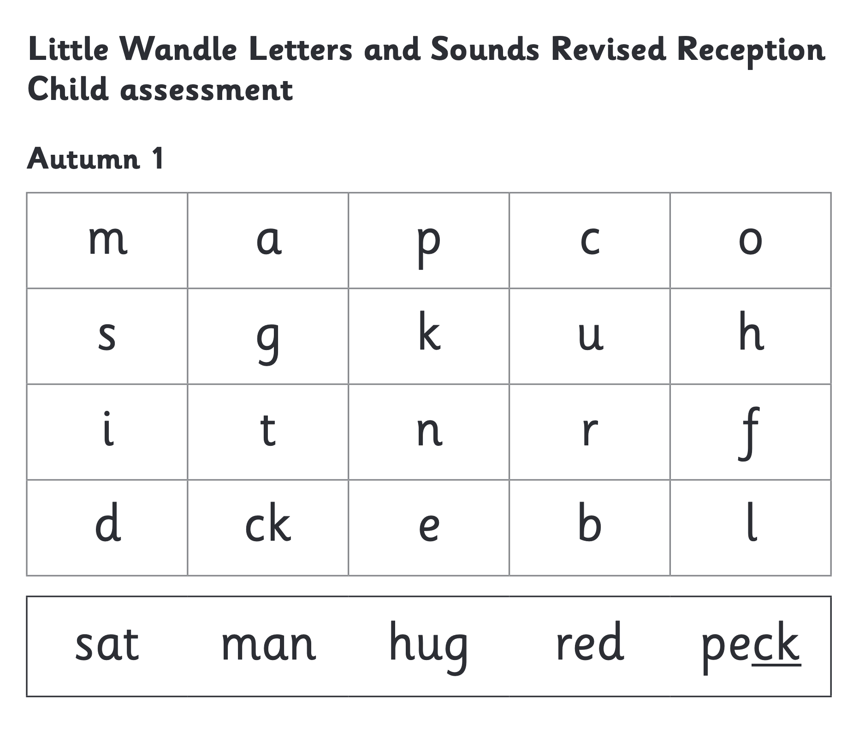
We use assessment to match your child the right level of book
Notes:
We assess your child every six weeks to check progress. Any child who needs extra support has daily keep-up sessions planned for them.

Slide 6
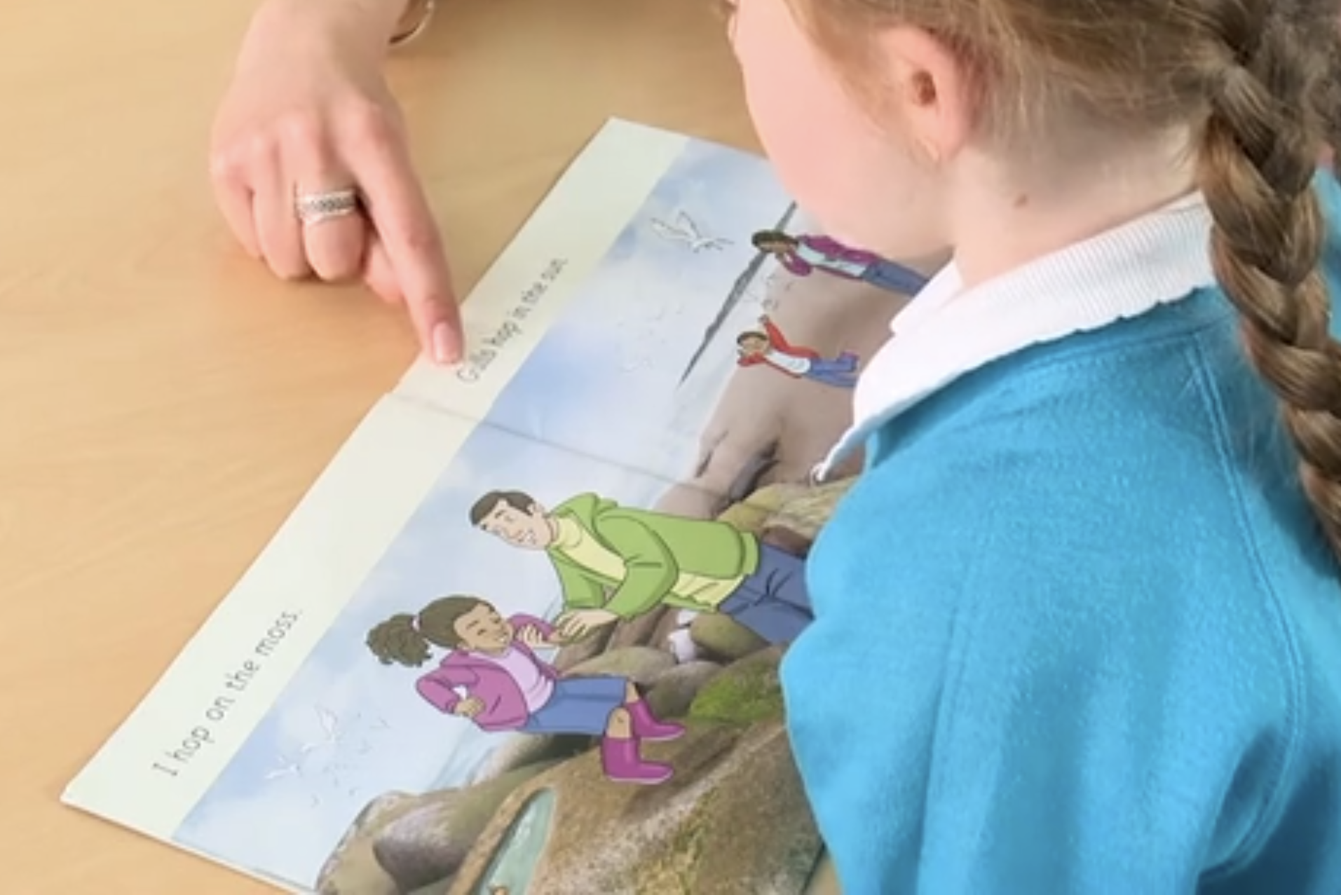
Reading a book at the right level
This means that your child should:
Know all the sounds and tricky words in their phonics book well
Read many of the words by silent blending (in their head) – their reading will be automatic
Only need to stop and sound out about 5% of the words by the time they bring the book home – but they should be able to do this on their own.

Slide 7
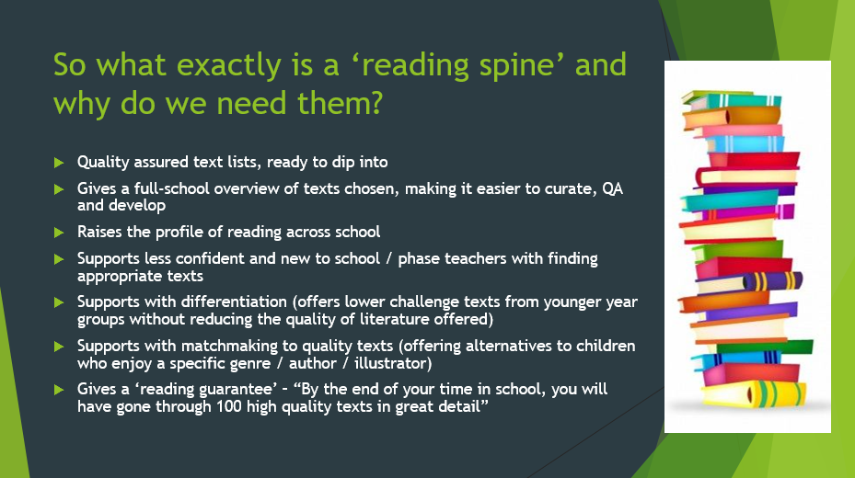

Slide 8
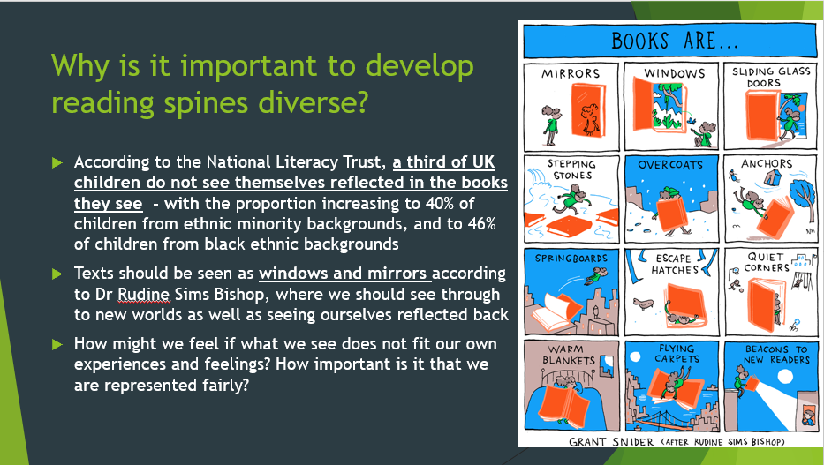

Slide 9

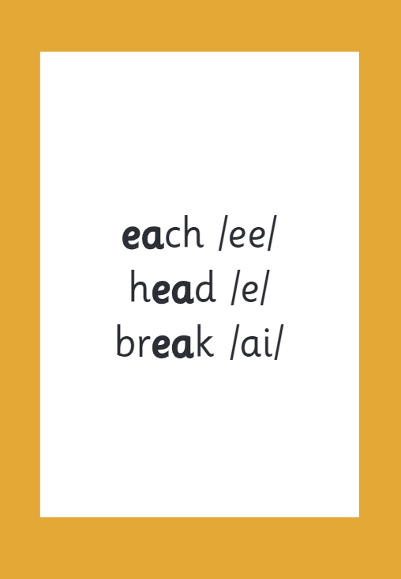
Reading and spelling
Notes:
This is an example of what the children learn in Year 1.
Children learn that there are graphemes that can have different sounds and sounds that can be made with different letters.
Use the backs and fronts of Phase 5 cards to show ‘ea’ and ‘ow’.

Slide 10
And all the different ways to write the phoneme sh:
shell
chef
special
caption
mansion
passion

Slide 11

Spelling
Say the word.
Segment the sounds.
Count the sounds.
Write them down.
Notes:
Model the process on a flipchart for the parents to see.

Slide 12

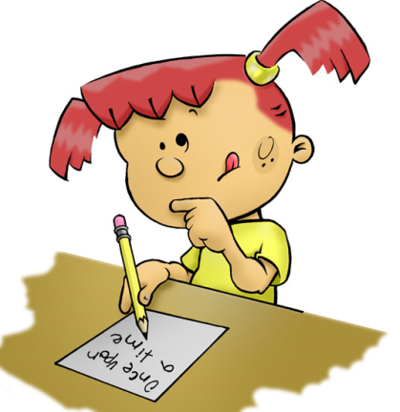
How is writing taught in KS1?
Inviting authors, poets, illustrators, playwrights etc. into school
Little Wandle Phonics
(Year 1 and 2) and Spelling (Year 2)
(25/30 mins daily)
Writing journeys – using rich text
(40-50 mins daily)
Interventions
Handwriting – daily
Cross-Curricular – through topic

Slide 13
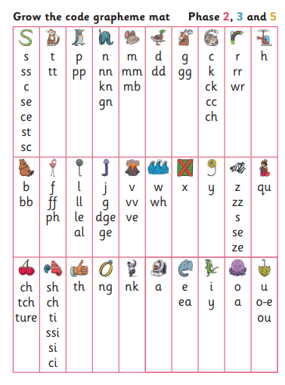
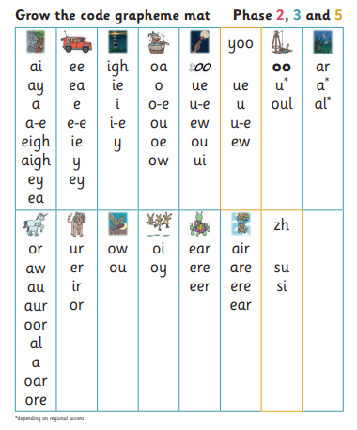
How is writing taught in KS1?

Slide 14
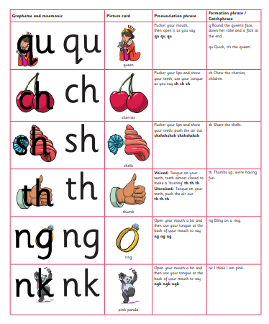
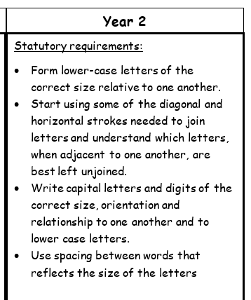
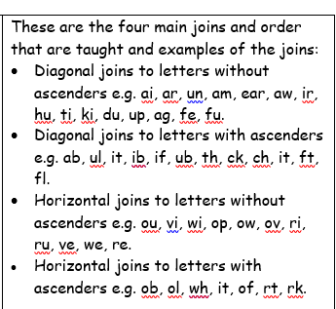
Handwriting

Slide 15
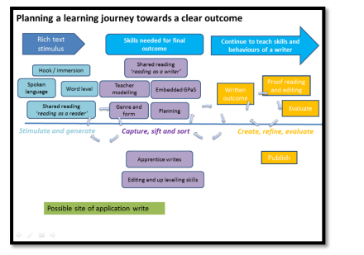

How is writing taught in KS1?

Slide 16



What we teach in Year 1?
Spelling using phonemes/digraphs/trigraphs
finger spaces
capital letters and full stops
Capital letters for names and ‘I’
Question marks and exclamation marks
joining using ‘and’
sequencing sentences
plural nouns
prefix ‘un’
Notes:
2 mins Teach more- adjectives, adverbs, verbs, to write for the reader and for a purpose- diary entry, letter, story, recount, instructions.

Slide 17

Word classes
Noun-
Verb-
Adjective-
Adverb-
A person, place or thing
A doing word
A describing word (describes the noun)
Describes how the “doing” was done.
Find the nouns, verbs and adjectives in the sentences:
Jack tiptoed nervously through the narrow hallway.
The cute baby giggled loudly as the dog wagged its fluffy tail.
Notes:
7 mins Good if you can use terminology at home
Quick games eg act out the adverb (pass the potato quickly, slowly, angrily, carefully etc along the line)
Verb- human puppet (willing parent or use Grace)
Adjective- describe the man in picture (personality and appearance)
Task of finding the word classes in sentences

Slide 18
Word classes
Noun-
Verb-
Adjective-
Adverb-
A person, place or thing
A doing word
A describing word (describes the noun)
Describes how the “doing” was done.
Find the nouns, verbs and adjectives in the sentences:
Jack tiptoed nervously through the narrow hallway.
The cute baby giggled loudly as the dog wagged its fluffy tail.
Notes:
7 mins Good if you can use terminology at home
Quick games eg act out the adverb (pass the potato quickly, slowly, angrily, carefully etc along the line)
Verb- human puppet (willing parent or use Grace)
Adjective- describe the man in picture (personality and appearance)
Task of finding the word classes in sentences

Slide 19
Punctuation
Full stops- to show the end of a sentence/statement.
Capital Letter – beginning of sentences, names, places
Tim is best friends with Sam.
Kate lives in London.
Question marks- when a question is asked.
Can you help please?
Do you have a spare pen?
Exclamation marks
How beautiful the sky is!
What an exciting journey that was!
Notes:
2 mins Technique- think it, say it, write it for writing sentences.
Using vocab- proper noun, pronoun
This punctuation links to sentence types

Slide 20
Sentence Types
Exclamatory – begins with a what or a how, contains a verb and a noun, end with !
What an exciting adventure that was!
How handsome the prince looks!
Commands – bossy sentences, imperative verbs
Don’t eat the sweets!
Cut the shape out.
Questions – Asks something, ends in a question mark
Can I come too?
What colour is the sky?
Statement – gives information, ends in a full stop
The bird has grey feathers.
Jack and Jill fell down the hill.
Notes:
3 mins Ch add correct punctuation to sentences by recognising type of sentence

Slide 21
Prefixes
root word | Un-
Happy | unhappy
lock | unlock
fair | unfair
Notes:
1 min
Saying opposite sentences with acting eg I am very happy vs I am very unhappy. etc

Slide 22

So, how can I support my child at home?
Use any opportunity to write for a purpose – Shopping list, birthday card etc.
When you are writing/typing/texting, ask your child to help you to remember which punctuation to use or how to spell etc.
Lots of opportunities for writing:
Post-it-notes
Notepad
whiteboard
Appealing pens
Ask your child to correct your writing for you (made up writing).
Spot the …. games when out with your child.
Spotting punctuation or grammar features when reading.
Use adverbs when cooking.
Adjectives to describe your surroundings.
Guess the verb acting games.
Orally telling stories/sentences.
Notes:
3 mins
Short and sweet and incidental learning is best. So child feels like the expert or doesn’t feel like they are learning.

Slide 23
Reading at home

Slide 24

The most important thing you can do is read with your child
Reading a book and chatting had a positive impact a year later on children’s ability to…
understand words and sentences
use a wide range of vocabulary
develop listening comprehension skills.
The amount of books children were exposed to by age 6 was a positive predictor of their reading ability two years later.
Parental involvement in the development of children’s reading skills: A five-year longitudinal study (2002) Senechal, M. and Lefvre, J
Notes:
Celebrate child’s success at school, make time for reading at home!

Slide 25
One of the greatest gifts adults can give is to read to children
Carl Sagan

Slide 26
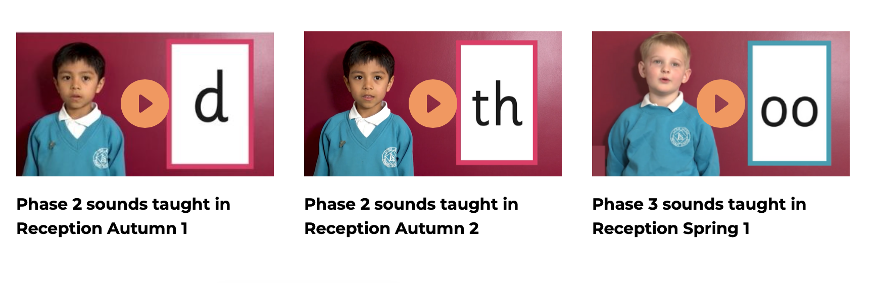
Supporting your child with phonics
Notes:
It is really important that you pronounce the sounds correctly at home if you are supporting your child. These videos are on the website for you to refer to and if you are unsure, please ask your child’s teacher.
Show the parents where to access the videos on the website and play them! https://www.littlewandlelettersandsounds.org.uk/resources/for-parents/

Slide 27
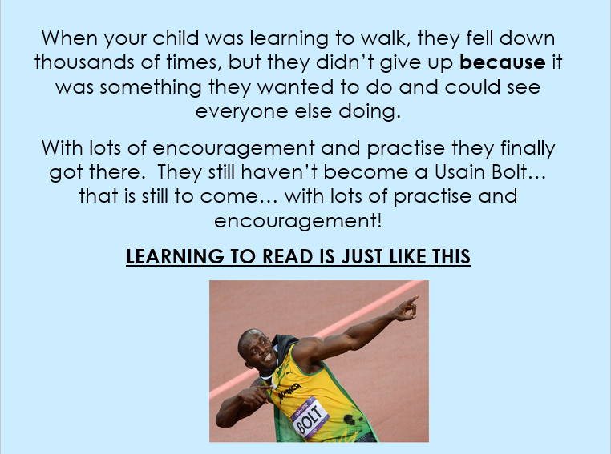
Learning to read and write is just like this!

