Slide 1
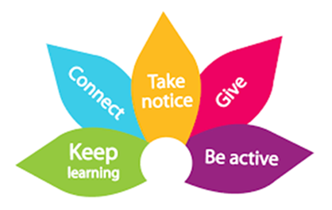

‘You cant teach a child to behave better by making them feel worse. When children feel better, they behave better.’
‘Get to understand your child, it is not about fixing them, it is about teaching them to regulate their emotions and understand boundaries’
Behaviour and Boundaries pt. 2

Slide 2
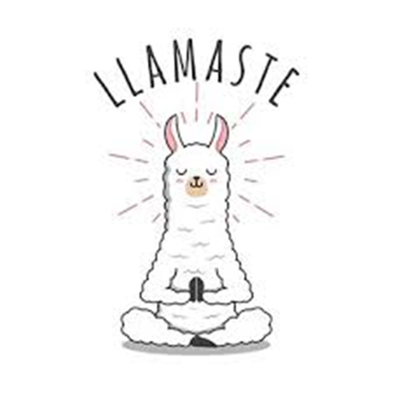

Activity
De-escalation stations

Slide 3


Refreshment time..

Slide 4
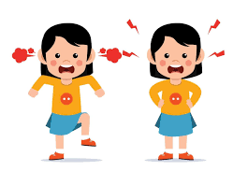
Why can my child be so aggressive?
There are no malicious thoughts behind this behaviour, and we cannot attribute human emotions to the chimp behaviour.
In other words, do not take it personally, this is not you – this is the ‘chimp’ taking over, it is all hot air!
Remember you are amazing , you are doing the best you can and the reason you are here is because you care so much and want to meet the need of this behaviour .

Slide 5

How we can prevent escalation before we hit the top of the cycle…
CALM CONNECT RESPOND
Do not ignore/do ignore
Meet the need/ Communicate and listen- What can I do to help?
Build the boundaries- socks example
Decide on the battle
Avoid/ plan better trigger situations- be smart
Fidgets/Stress ball/Cold Water/Ice Lolly
De-escalation station/Distraction and diversion
Ask them to do a job – Counting and sorting – this affects the part of the brain that releases melatonin, the calming/sleep hormone. This will also boost self esteem – they are being helpful/ feeling important.
Pillow fight / Wrestling /Throwing/Catching can get that physical aggression before we escalate.
TAKING THEM OUT OF THEIR EMOTIONAL BRAIN INTO THEIR RATIONAL THINKING BRAIN

Slide 6
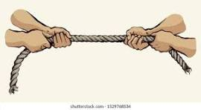
Tug of war
Don’t pick up that rope!
Do I want peace or do I want to win?

Slide 7
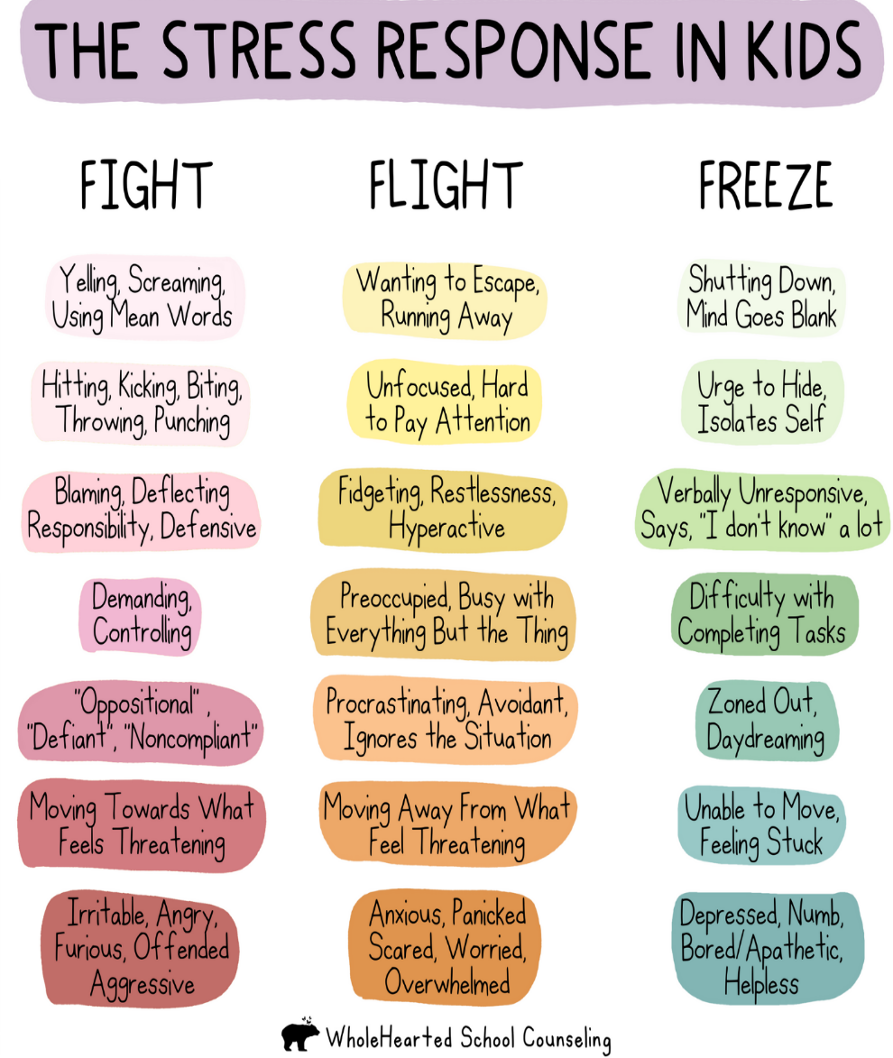
Fight, Flight, Freeze

Slide 8

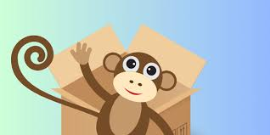
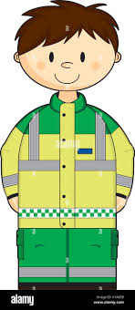

LET THEM FLIP!

Slide 9

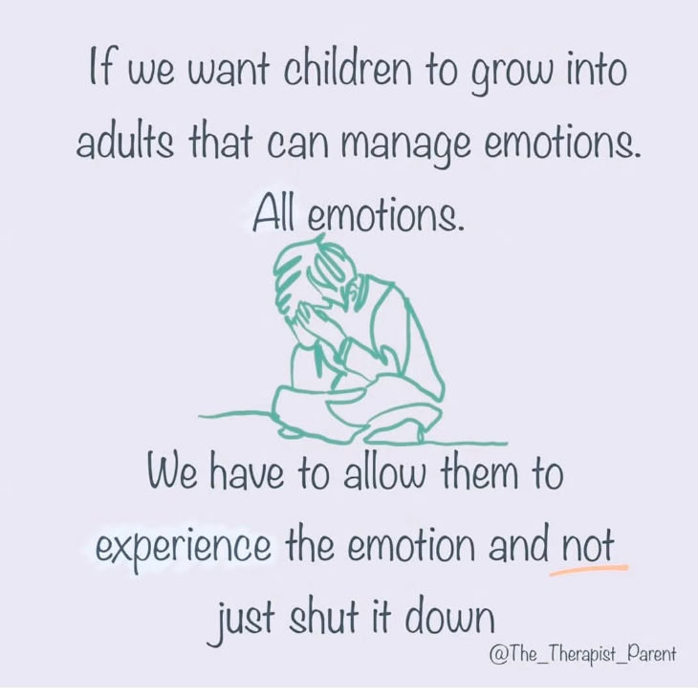
LET THEM FLIP!

Slide 10
What are the number 1 mistakes when managing behaviour?
Not putting yourself first! If we don’t put ourselves first, we have a smaller ability to help. We get stuck in the immediate irrational brain and cannot think about the longer term bigger picture.
Being calm, relaxed helps you have a much better grounded approach.
Trying to contain it !
Become the Paramedic!

Slide 11

How do these behaviours make us feel ?

Slide 12




Behavioural parenting styles
This parent works hard and tries to make everything right. They are very protective and are ready to pop their child back into their protective pouch at the first sign of distress.
These parents tend to use a logical and almost business like approach to help their child with their anxieties. They can be stubborn and set in their ways.
The ankle biter - this parent is persistent and will try to cajole their child, with a tendency towards micro-management. They may be more prone to nagging and over-control. This tends to wear out not only you but also your children, so often they don’t listen anymore.
This parent provides the right balance of care and control. Sometimes they might swim ahead and lead by example. At other times they swim alongside giving encouragement. Eventually, they can swim quietly behind, watching so they don’t lose their way.

Slide 13
Your Toolkit
Don’t pick up that rope
Take a moment
Avoid retaliation
Remove yourself from the conflict
Engage your computer/ your rational brain
If they need to flip- let them- become the paramedic!
Keep it calm, Keep it simple
If you see a need, meet it
Give them a ‘Get out’- this could be distraction or wondering out loud?
Don’t always follow textbook rules
Language to use: remind them that you love them, it is the behaviour you dislike.
WHATEVER PART OF YOUR TOOLKIT YOU DECIDE TO USE – STAY CONSISTENT!

Slide 14
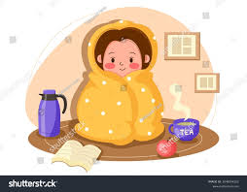

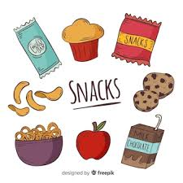
The Plateau Recovery Stage
This is where you may see tears/exhaustion and a need to reconnect
Gentle talk about their favourite things
A drink of water and a snack – they will be exhausted
Do not ask provocative questions: ‘ What did you do that for?’, ‘What is wrong with you?’ ‘
Allow time for recovery (this could take the whole day)
A comforting hug/blanket

Slide 15
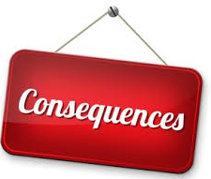


Consequences

Slide 16
Consequences
Natural consequences- Why do children learn better this way?
It is easier to understand and remember the connection between the natural consequence and the
behaviour that led to it.
Logical consequences- we may choose to apply this type of consequence if a natural consequence isn’t appropriate and to set some boundaries – the cause and effect.
Illogical consequences- Its better to have a consequence than none at all, something you can control and something they card about
Keep it short , don’t make it last all week, try to implicate the consequence in relative time to the behaviour.
Give choices , rather than orders
Try not to make threats that you cannot follow through on , your words will lose their impact – also children are smarter than we give them credit for!
Keep calm and keep it clear, anger breeds anger and much parental anger comes from frustration over a feeling of loss. When a consequence is clear, it’s much easier for the parent to remain calm giving it.

Slide 17


Baskets and Boundaries
Basket A:
Non-negotiable issues
Basket B:
Negotiable issues
Basket C:
Issues to forget for now

Slide 18
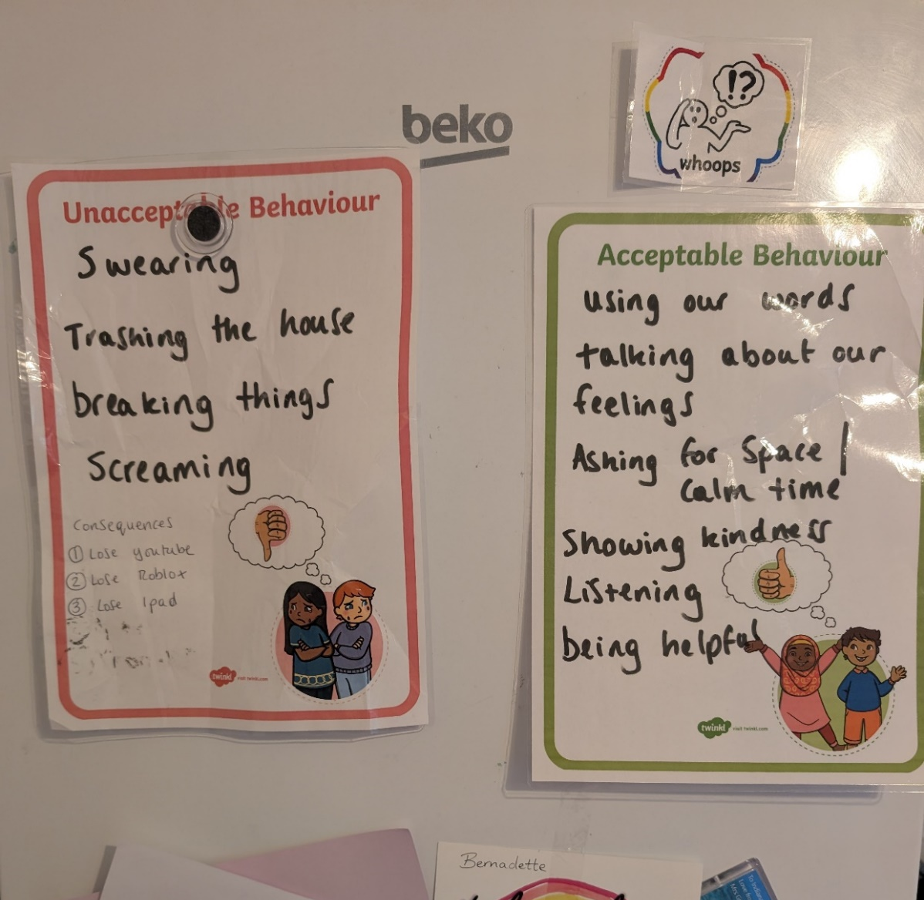

Consequences

Slide 19

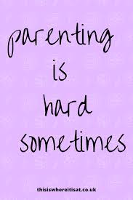
Your self talk
They are having a hard time, not giving me a hard time
Get them to share my calm, don’t join their chaos
I am in charge of me staying calm, no matter how my child is acting or behaving
All feelings are OK. My job is to help my child manage them,
Be a good role model, I can remain calm, set the example
I will be the thermostat, not the thermometer

Slide 20
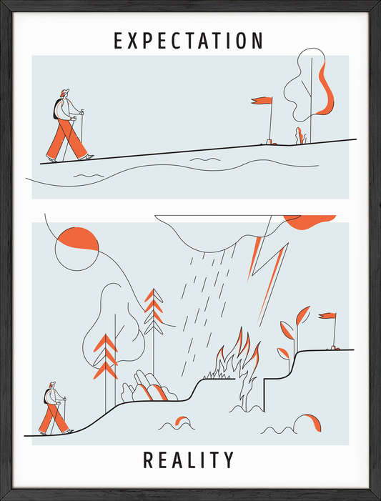
True story….

