Slide 1
Year 2 Maths Parent Workshop
14th October 2022
Welcome, please add your child’s name to the list so I can collect them in a moment!

Slide 2
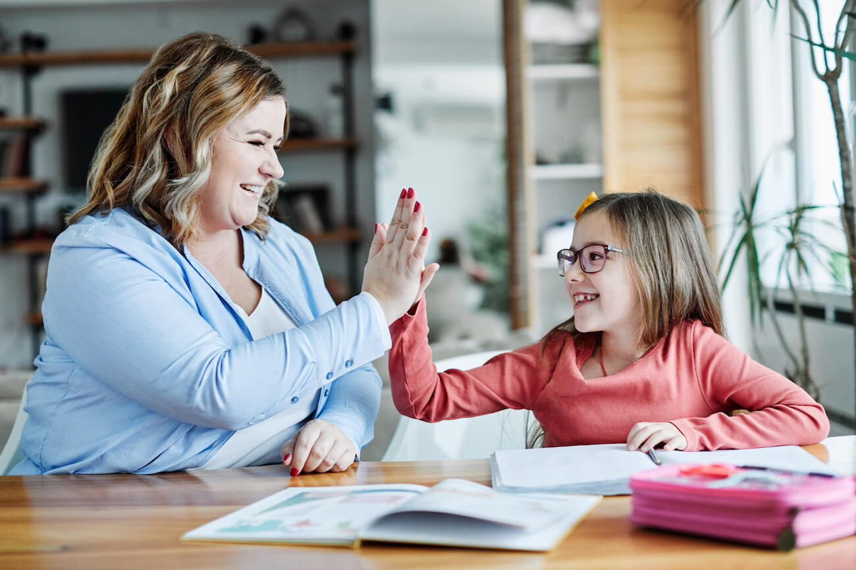
This Morning
… is a chance to share with your child, some of the ways they learn maths at school; to enable you to support them at home.

Slide 3

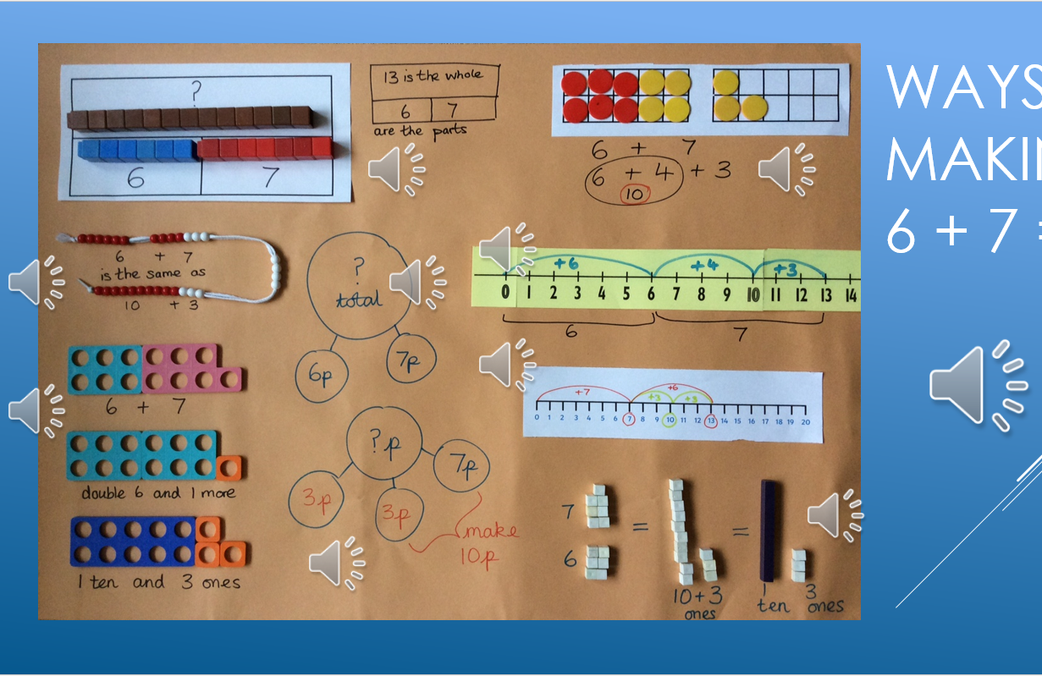
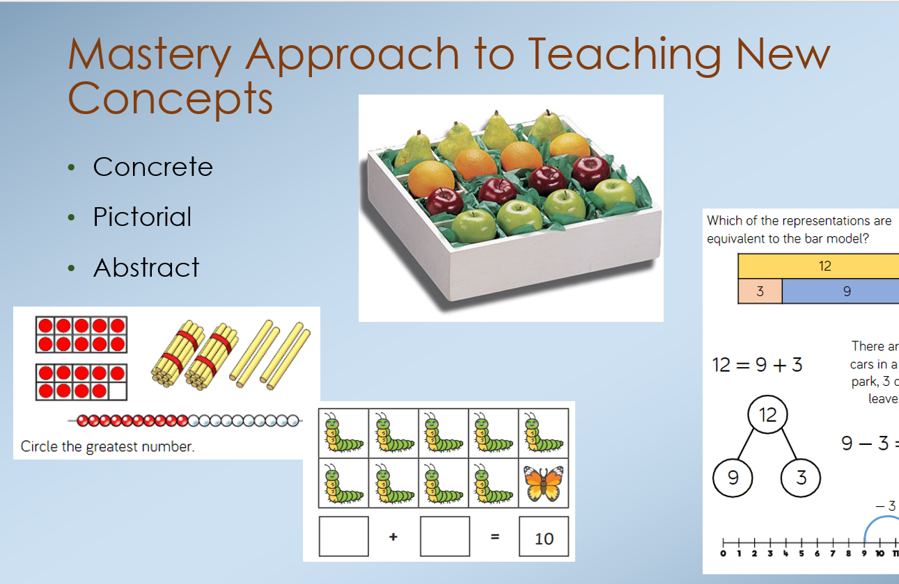
Curriculum Information
For information about our maths curriculum, please refer to past Parent Workshop Power Points on the school website
Link: https://www.catherington.hants.sch.uk/mathematics-curriculum/

Slide 5
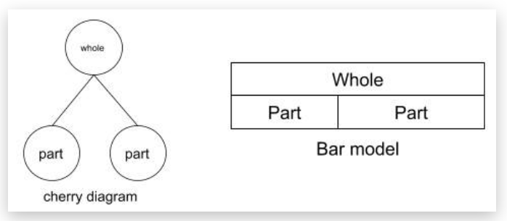
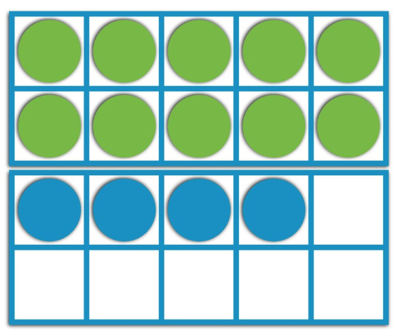

Images & Models
Enable children to see the numbers involved in solving a maths question.

Slide 6
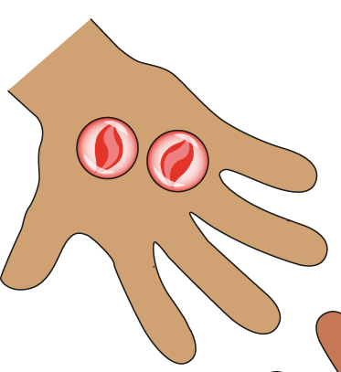
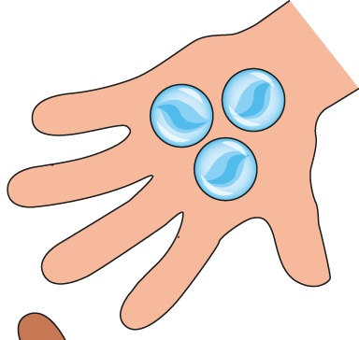
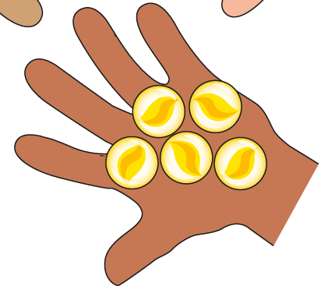
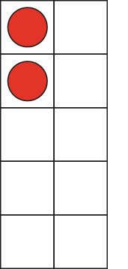
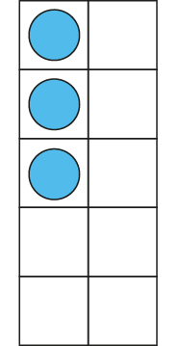
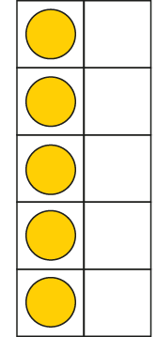
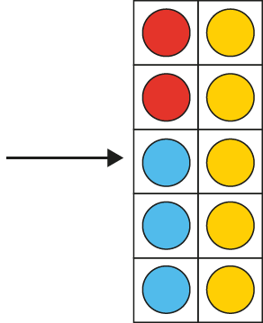



Addition: three numbers
2 + 3 + 5
= 10

Slide 7

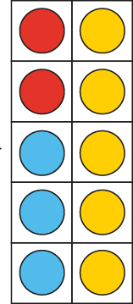
Addition: three numbers
10 = 2 + 3 + 5
Notes:
Madison has two red marbles, Charlie has three blue marbles and Asif has five yellow marbles. They have ten marbles altogether.

Slide 8
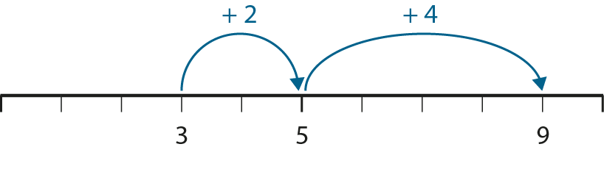
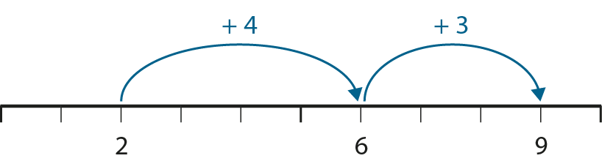
Addition: three numbers
3 + 2 + 4
= 2 + 4 + 3

Slide 9
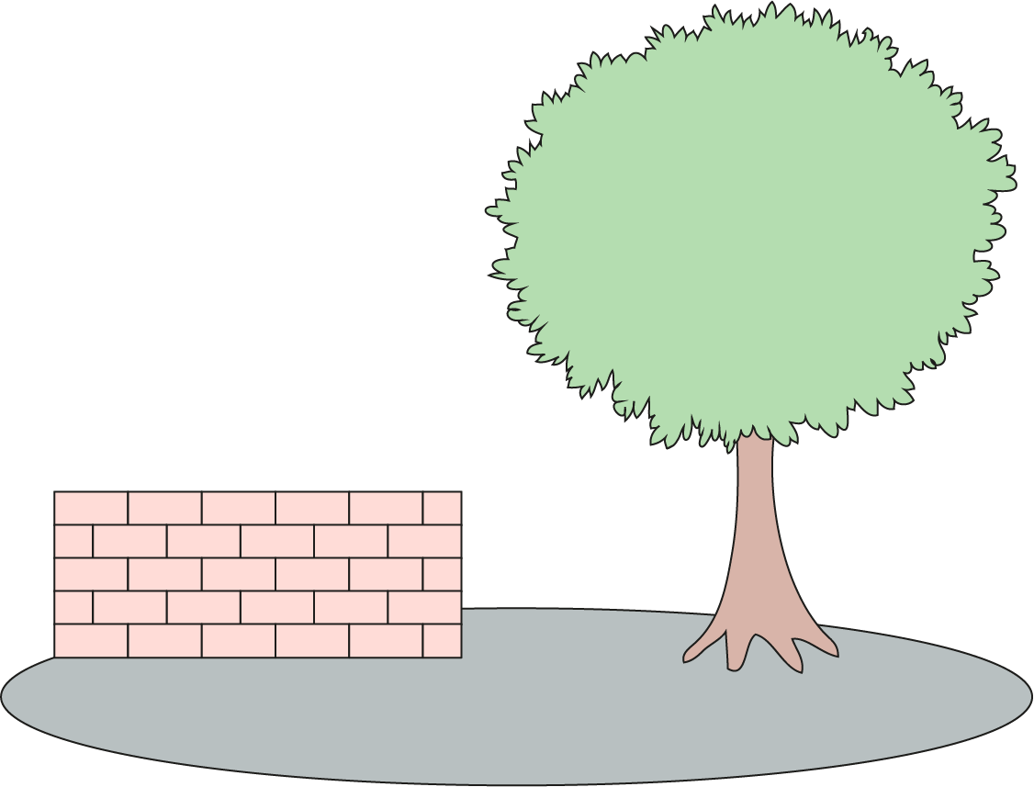

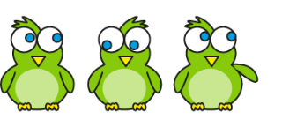

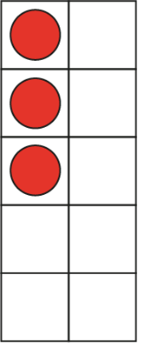
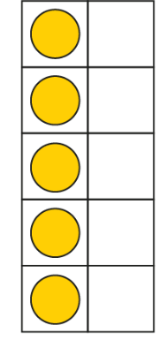
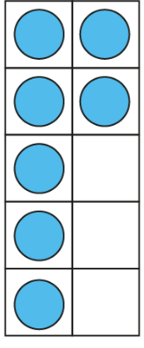



Addition: three numbers- finding 10
5
+ 10
3
+ 5
+ 7
= 5 + 10
3
+ 5
+ 7

Slide 10
Addition: three numbers- finding 10
5 + 6 + 5 =
16

Slide 11
Addition: three numbers- finding 10
3 + 3 + 7 =
13

Slide 12
Addition: three numbers- finding 10
8 + 4 + 2 =
14

Slide 13
Addition: three numbers- finding 10
7 + 5 + 5
4 + 8 + 5
7 + 6 + 2
1 + 3 + 9
Can make 10 | Cannot make 10

Slide 14
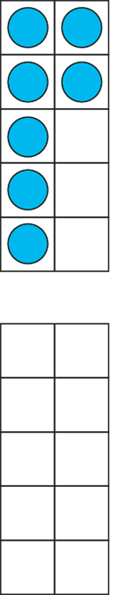
Addition: bridging 10
7 + 5
= 7 + 3 + 2
= 10 + 2
Notes:
A ride at the funfair has ten seats in each carriage. You have to fill up the whole carriage before children can get in a new one. There are seven children in the first carriage. Five more get on. How many children are there altogether?’
‘Three children can get in the first carriage and two children get in the next carriage.

Slide 15
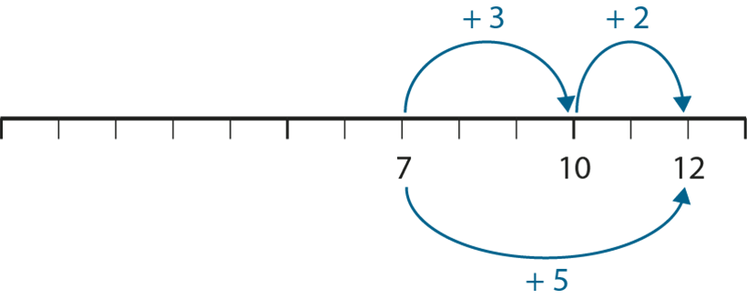
Addition: bridging 10

Slide 16


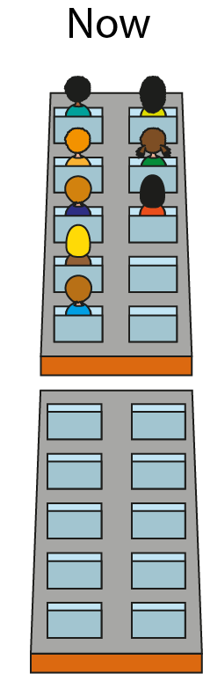
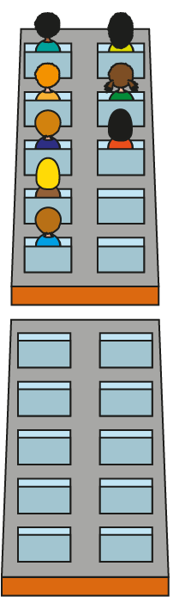







Addition and Subtraction: bridging 10

Slide 17




Addition and Subtraction: bridging 10
− 4
− 2
− 2
8
10
12

Slide 18




Addition and Subtraction: bridging 10

Slide 19
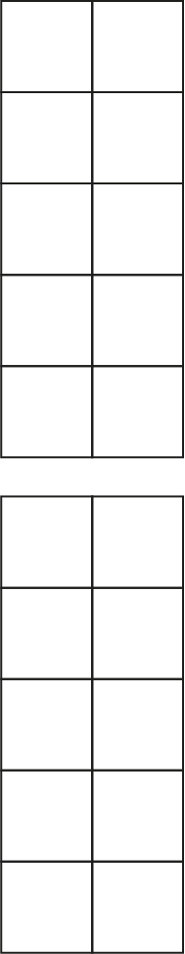







Addition and Subtraction: bridging 10
15 − 9
5
4
15
− 5
= 10
10
− 4
= 6
15
− 9
= 6

Slide 20



Addition and Subtraction: bridging 10

Slide 21
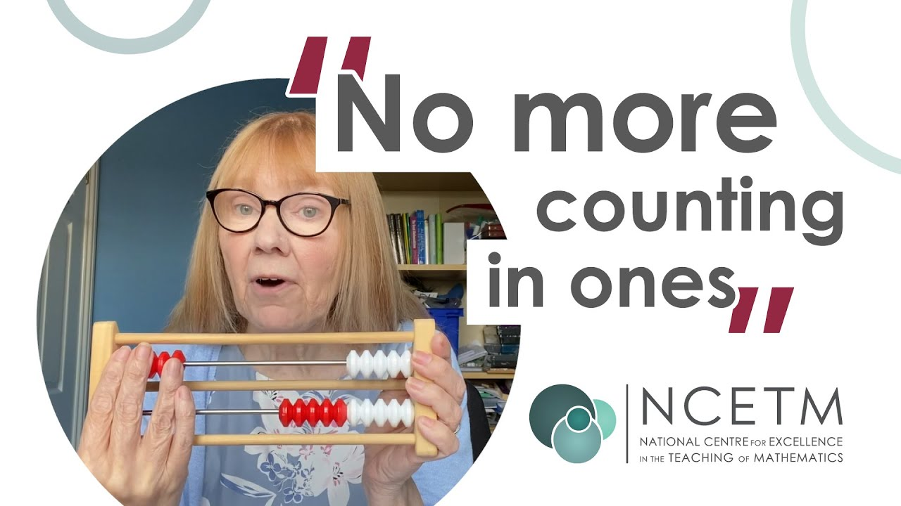
Mental Maths Project
https://www.youtube.com/watch?v=gtb7X2UJNWw

Slide 22
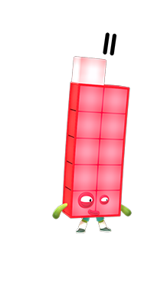
Make each number using all the beads on the top row
10 needs _____ to make _____ ;
_____ is made of 10 and _____ .
Image © 2021 Alphablocks Ltd. All rights reserved. Mastering Number 2021/22 ncetm.org.uk

Slide 23
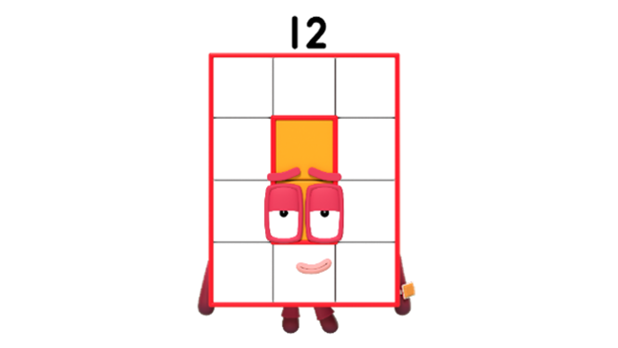
10 needs _____ to make _____ ;
_____ is made of 10 and _____ .
Image © 2021 Alphablocks Ltd. All rights reserved. Mastering Number 2021/22 ncetm.org.uk

Slide 24
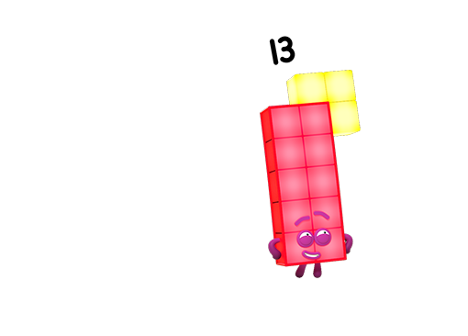
10 needs _____ to make _____ ;
_____ is made of 10 and _____ .
Image © 2021 Alphablocks Ltd. All rights reserved. Mastering Number 2021/22 ncetm.org.uk

Slide 25
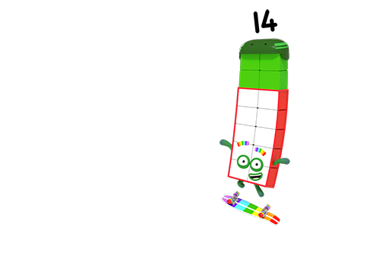
10 needs _____ to make _____ ;
_____ is made of 10 and _____ .
Image © 2021 Alphablocks Ltd. All rights reserved. Mastering Number 2021/22 ncetm.org.uk

Slide 26
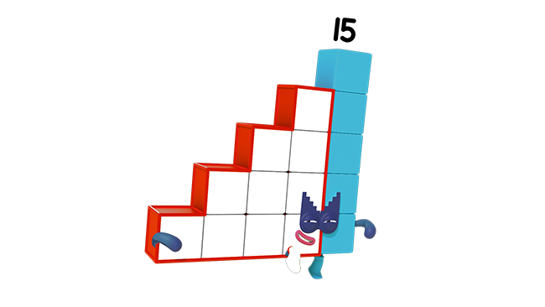
10 needs _____ to make _____ ;
_____ is made of 10 and _____ .
Image © 2021 Alphablocks Ltd. All rights reserved. Mastering Number 2021/22 ncetm.org.uk

Slide 27
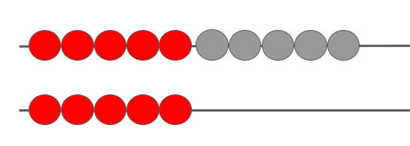
How did we ‘see’10 and 5 in 15?
10
5
10
5
Mastering Number 2021/22 ncetm.org.uk

Slide 28
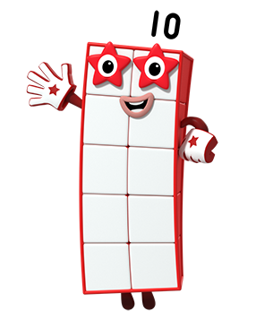
Can you make the numbers I show you using your rekenrek?
Image © 2021 Alphablocks Ltd. All rights reserved. Mastering Number 2021/22 ncetm.org.uk

Slide 29
12
Twelve
_____ is made of 10 and _____ ;
10 and _____ make _____ .
Mastering Number 2021/22 ncetm.org.uk

Slide 30
15
Fifteen
_____ is made of 10 and _____ ;
10 and _____ make _____ .
Mastering Number 2021/22 ncetm.org.uk

Slide 31
19
Nineteen
_____ is made of 10 and _____ ;
10 and _____ make _____ .
Mastering Number 2021/22 ncetm.org.uk

Slide 32
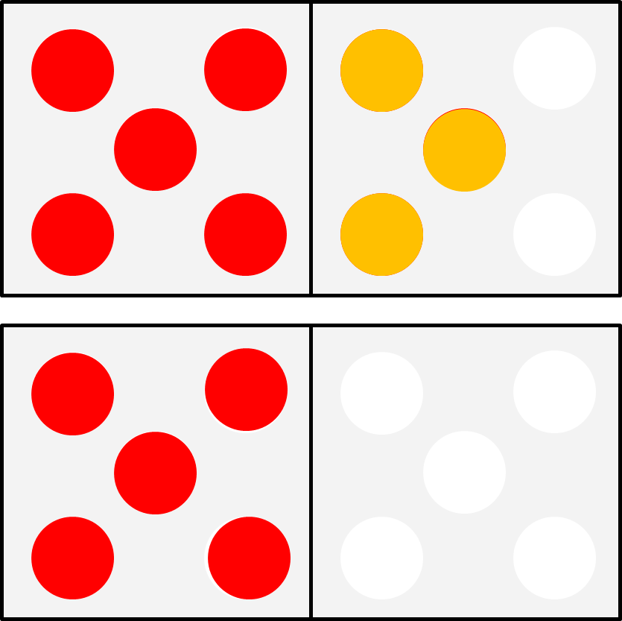
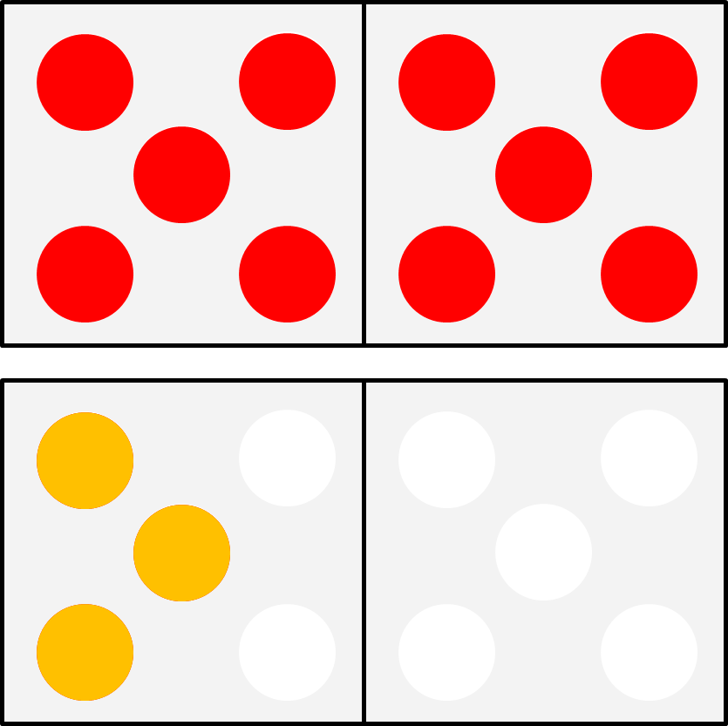
What is the same? What is different?
13
Thirteen
Mastering Number 2021/22 ncetm.org.uk

Slide 33
Guess the number your partner makes
Then, make the SAME number in a DIFFERENT way
11
12
13
14
15
Mastering Number 2021/22 ncetm.org.uk

Slide 34
Rekenrek calculations
How could you use a rekenrek to solve our problems from earlier?
3 + 2 + 4
3 + 5 + 7
7 + 5
12 – 4
15 - 9

Slide 35

Mental Maths App

Slide 36

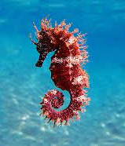
Thank You & Feedback
Thank you for coming, I hope this has given you some idea of how we teach maths in Year 2.
If you would like any further information on how we teach maths- check out the Power Points on the website or come and ask me anytime ☺.
Seahorses- time to say, “Goodbye”.

