Slide 1
Year 1 Maths Parent Workshop
7th October 2022
Welcome, please add your child’s name to the list so I can collect them in a moment!

Slide 2
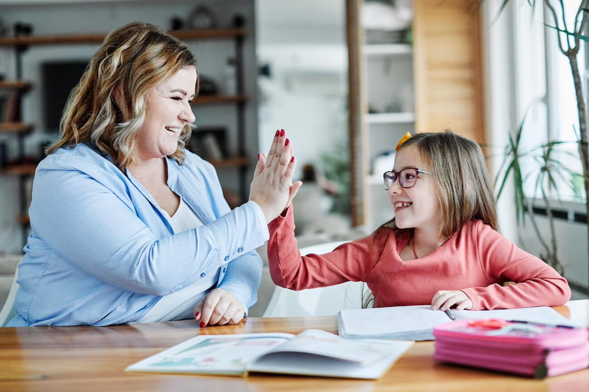
This Morning
… is a chance to share with your child, some of the ways they learn maths at school; to enable you to support them at home.

Slide 3
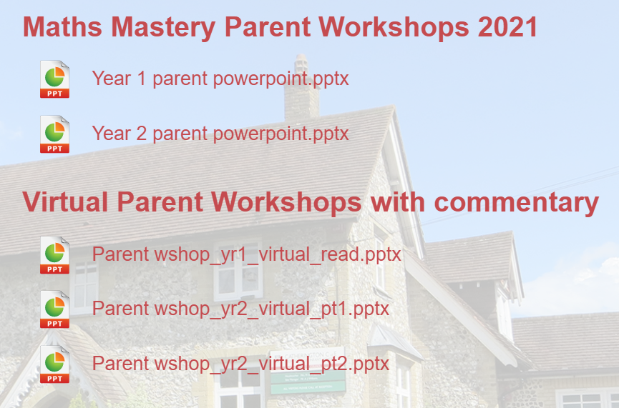
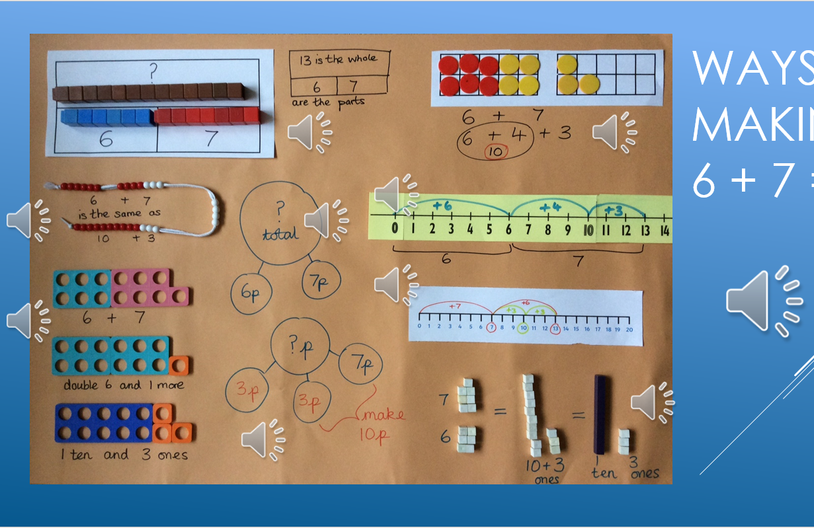
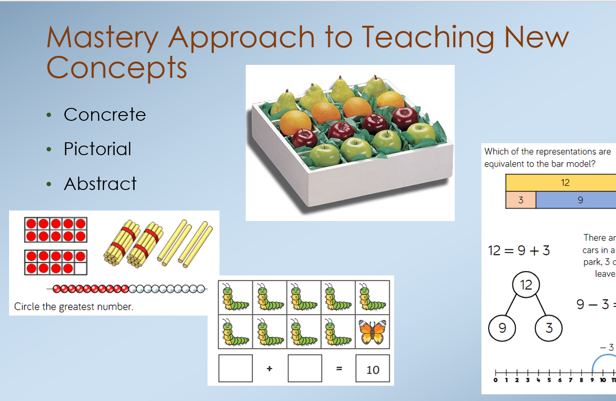
Curriculum Information
For information about our maths curriculum, please refer to past Parent Workshop Power Points on the school website
Link: https://www.catherington.hants.sch.uk/mathematics-curriculum/

Slide 5
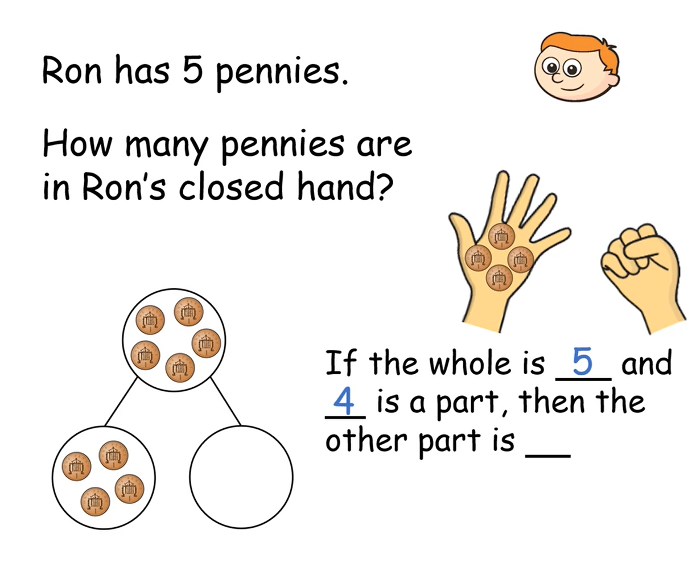
Part Whole Models
Enable children to see the numbers involved in solving a maths question.

Slide 6

1.2 Part–part–whole – step 4:4

Slide 7
1.2 Part–part–whole – step 4:4

Slide 8
1.2 Part–part–whole – step 4:4

Slide 9
1.2 Part–part–whole – step 4:4

Slide 10
1.2 Part–part–whole – Steps 4:4
1.2 Part–part–whole – step 4:4
5
1
4

Slide 11
1.2 Part–part–whole – step 4:4
5
2
3

Slide 12
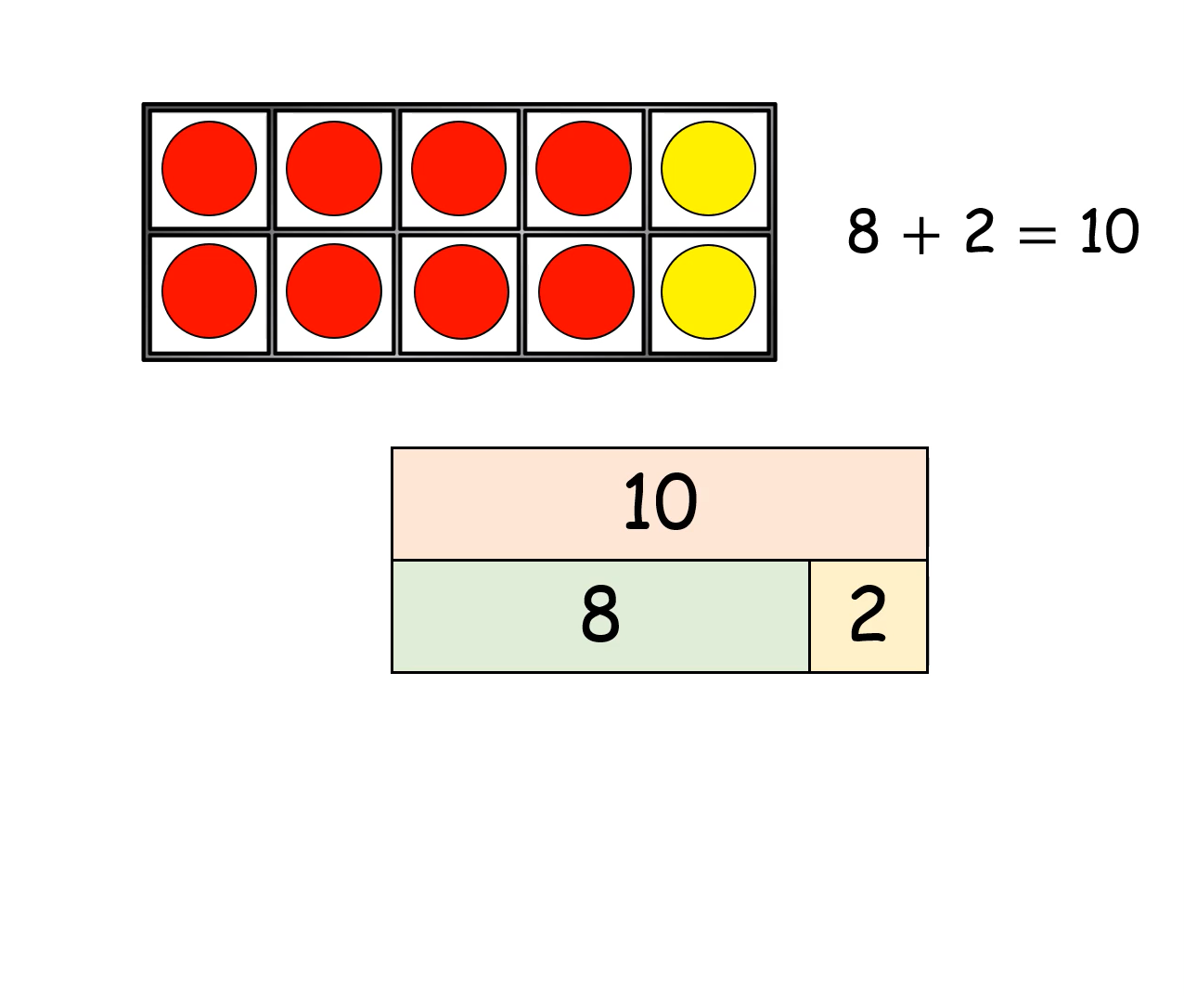
Tens Frames &
Bar Models

Slide 13
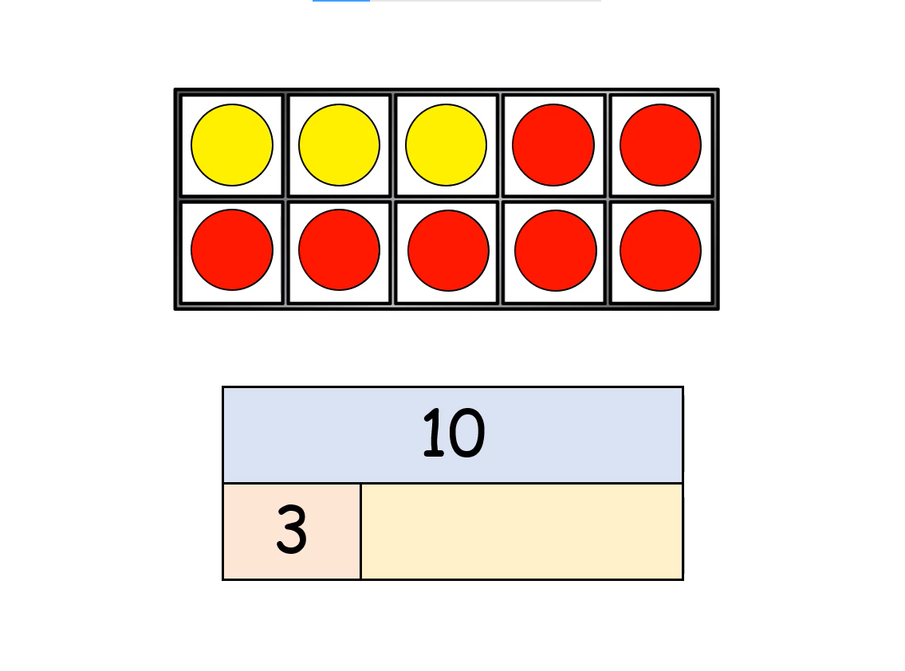
Tens Frames &
Bar Models

Slide 14
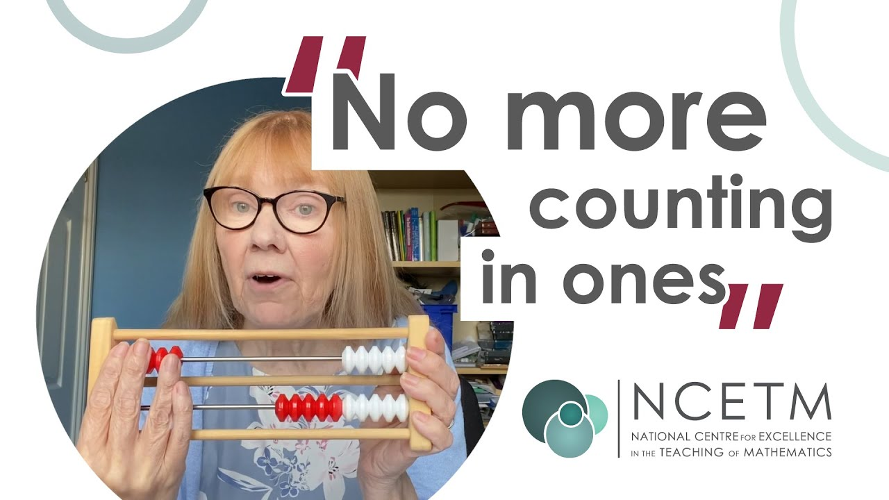
Mental Maths Project
https://www.youtube.com/watch?v=gtb7X2UJNWw

Slide 15


What does 8 look like on the rekenrek?
Can you imagine 8 birds on the line?
Mastering Number 2021/22 ncetm.org.uk

Slide 16
_____ needs _____ to make 8.
Mastering Number 2021/22 ncetm.org.uk

Slide 17
_____ needs _____ to make 8.
Mastering Number 2021/22 ncetm.org.uk

Slide 18
_____ needs _____ to make 8.
Mastering Number 2021/22 ncetm.org.uk

Slide 19
_____ needs _____ to make 8.
Mastering Number 2021/22 ncetm.org.uk

Slide 20
_____ needs _____ to make 8.
Mastering Number 2021/22 ncetm.org.uk

Slide 21
_____ needs _____ to make 8.
Mastering Number 2021/22 ncetm.org.uk

Slide 22
_____ needs _____ to make 8.
Mastering Number 2021/22 ncetm.org.uk

Slide 23
_____ needs _____ to make 8.
Mastering Number 2021/22 ncetm.org.uk

Slide 24
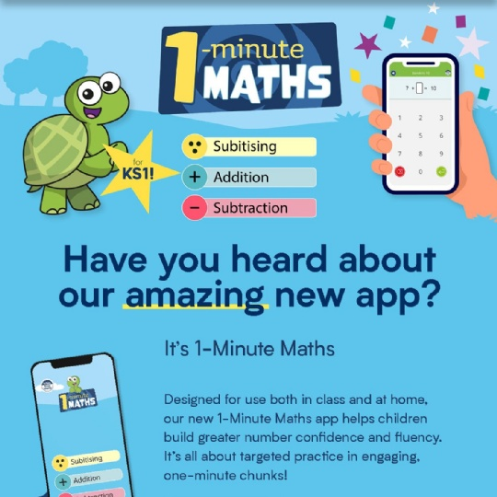
Mental Maths App

Slide 25


Thank You & Feedback
Thank you for coming, I hope this has given you some idea of how we teach maths in Year 1.
If you would like any further information on how we teach maths- check out the Power Points on the website or come and ask me anytime ☺.
Turtles- time to say, “Goodbye”.

