Slide 1



Writing workshop
Stuart Dickenson
English Lead

Slide 2

Aims:
How do we teach your children to write?
What does progress look like?
How can you support your child with writing at home?
Notes:
1 min

Slide 3



How is writing taught in KS1?
Inviting authors, poets, illustrators, playwrights etc. into school
Little Wandle Phonics
(Year 1 and 2) and Spelling (Year 2)
(25/30 mins daily)
Writing journeys – using rich text
(40-50 mins daily)
Interventions
Handwriting – daily
Cross-Curricular – through topic
Notes:
2 mins
English learning happens all of teh time as it is in everything!
English lesson- variety of structures: whiteboard work, partner, independent, group, shared writing, teacher modelling, sometimes linked to topic, different stimuli

Slide 4
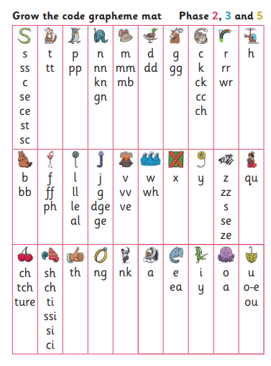
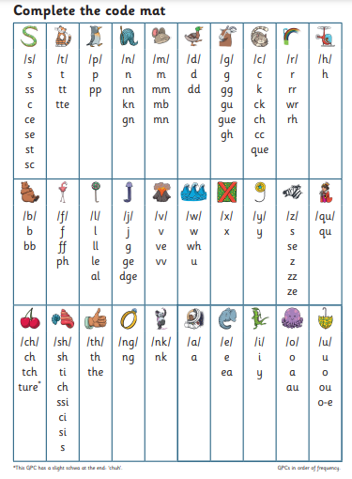
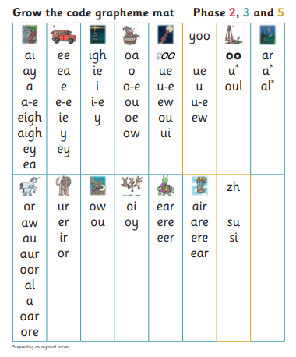
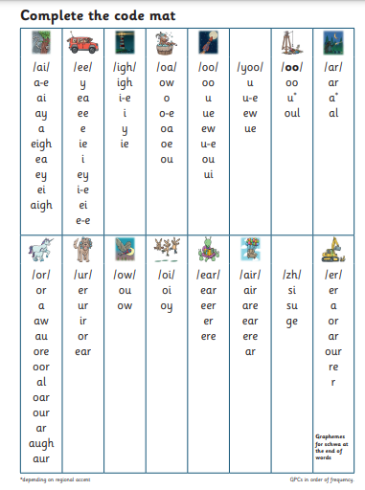
How is writing taught in KS1?
Spelling with confidence – Best bet.

Slide 5
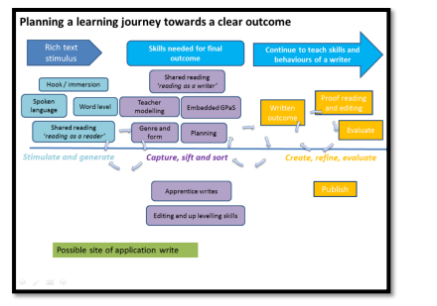

How is writing taught in KS1?

Slide 6


What we teach in Year 1?
Spelling using phonemes/digraphs/trigraphs
finger spaces
capital letters and full stops
Capital letters for names and ‘I’
Question marks and exclamation marks
joining using ‘and’
sequencing sentences
plural nouns
prefix ‘un’
Notes:
2 mins Teach more- adjectives, adverbs, verbs, to write for the reader and for a purpose- diary entry, letter, story, recount, instructions.

Slide 7

What we teach in year 2
commas for list
subordination, coordination,
expanded noun phrases
apostrophes for contractions and possession,
Sentence types: statement, question, exclamation, command
compound words
suffixes- ness –er, -ful, -less –est, -ly
present/past, progressive form of verbs,
Notes:
2 mins
Consolidating all of year 1 and….. BUT we still make it fun and interesting with purpose and different text types.

Slide 8

Word classes
Noun-
Verb-
Adjective-
Adverb-
A person, place or thing
A doing word
A describing word (describes the noun)
Describes how the “doing” was done.
Find the nouns, verbs and adjectives in the sentences:
Jack tiptoed nervously through the narrow hallway.
The cute baby giggled loudly as the dog wagged its fluffy tail.
Notes:
7 mins Good if you can use terminology at home
Quick games eg act out the adverb (pass the potato quickly, slowly, angrily, carefully etc along the line)
Verb- human puppet (willing parent or use Grace)
Adjective- describe the man in picture (personality and appearance)
Task of finding the word classes in sentences

Slide 9
Word classes
Noun-
Verb-
Adjective-
Adverb-
A person, place or thing
A doing word
A describing word (describes the noun)
Describes how the “doing” was done.
Find the nouns, verbs and adjectives in the sentences:
Jack tiptoed nervously through the narrow hallway.
The cute baby giggled loudly as the dog wagged its fluffy tail.
Notes:
7 mins Good if you can use terminology at home
Quick games eg act out the adverb (pass the potato quickly, slowly, angrily, carefully etc along the line)
Verb- human puppet (willing parent or use Grace)
Adjective- describe the man in picture (personality and appearance)
Task of finding the word classes in sentences

Slide 10
Punctuation
Full stops- to show the end of a sentence/statement.
Capital Letter – beginning of sentences, names, places
Tim is best friends with Sam.
Kate lives in London.
Question marks- when a question is asked.
Can you help please?
Do you have a spare pen?
Exclamation marks
How beautiful the sky is!
What an exciting journey that was!
Notes:
2 mins Technique- think it, say it, write it for writing sentences.
Using vocab- proper noun, pronoun
This punctuation links to sentence types

Slide 11
Sentence Types
Exclamatory – begins with a what or a how, contains a verb and a noun, end with !
What an exciting adventure that was!
How handsome the prince looks!
Commands – bossy sentences, imperative verbs
Don’t eat the sweets!
Cut the shape out.
Questions – Asks something, ends in a question mark
Can I come too?
What colour is the sky?
Statement – gives information, ends in a full stop
The bird has grey feathers.
Jack and Jill fell down the hill.
Notes:
3 mins Ch add correct punctuation to sentences by recognising type of sentence

Slide 12
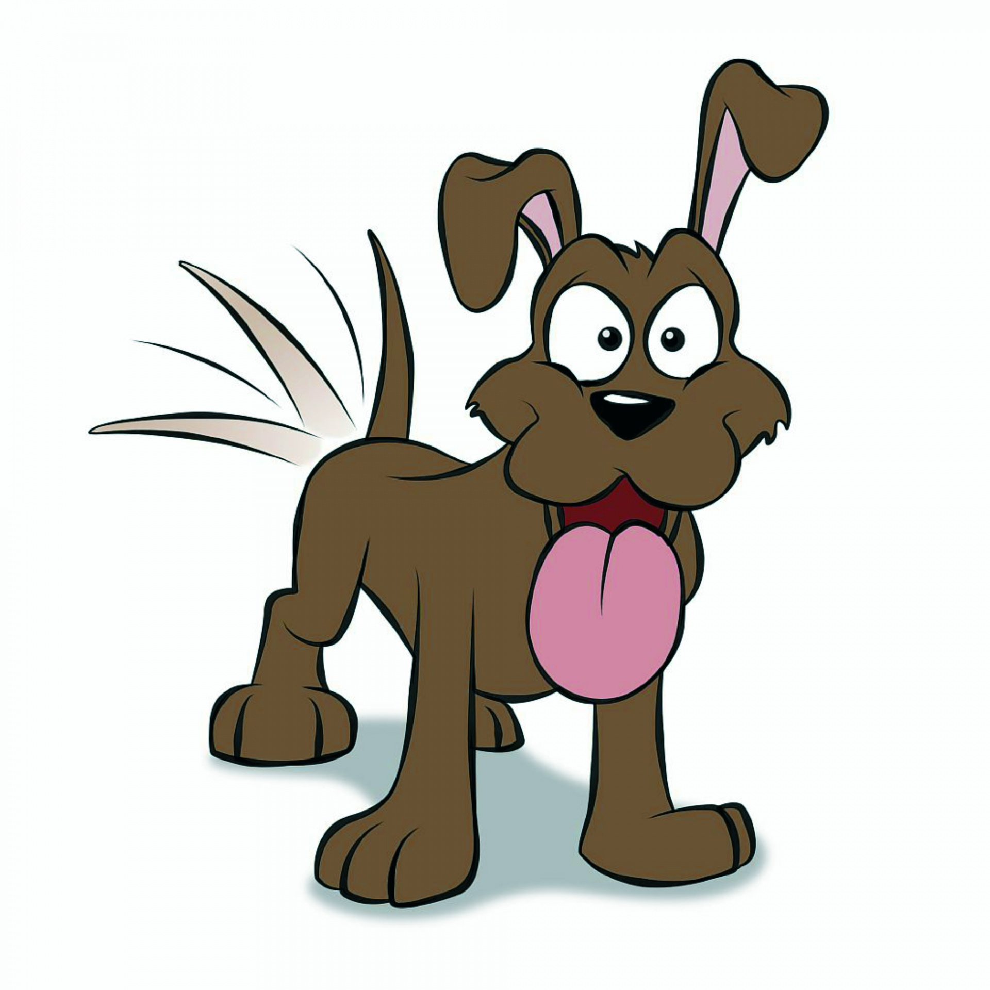
Punctuation continued
Apostrophes for possession and contractions
Dad’s socks are smelly.
I sat on my sister’s chair.
The dogs’ tails were fluffy.
I will- I’ll
Would not- wouldn’t
Where is Julie’s coat?
The girl’s are wearing blue.
The boy’s toy is broken.
The teacher’s pen was red.
Apples and pears are on special offer!
Ladies’ skirts on sale here.
Notes:
5 mins Stand up if correct, sit down if wrong- audience involved

Slide 13

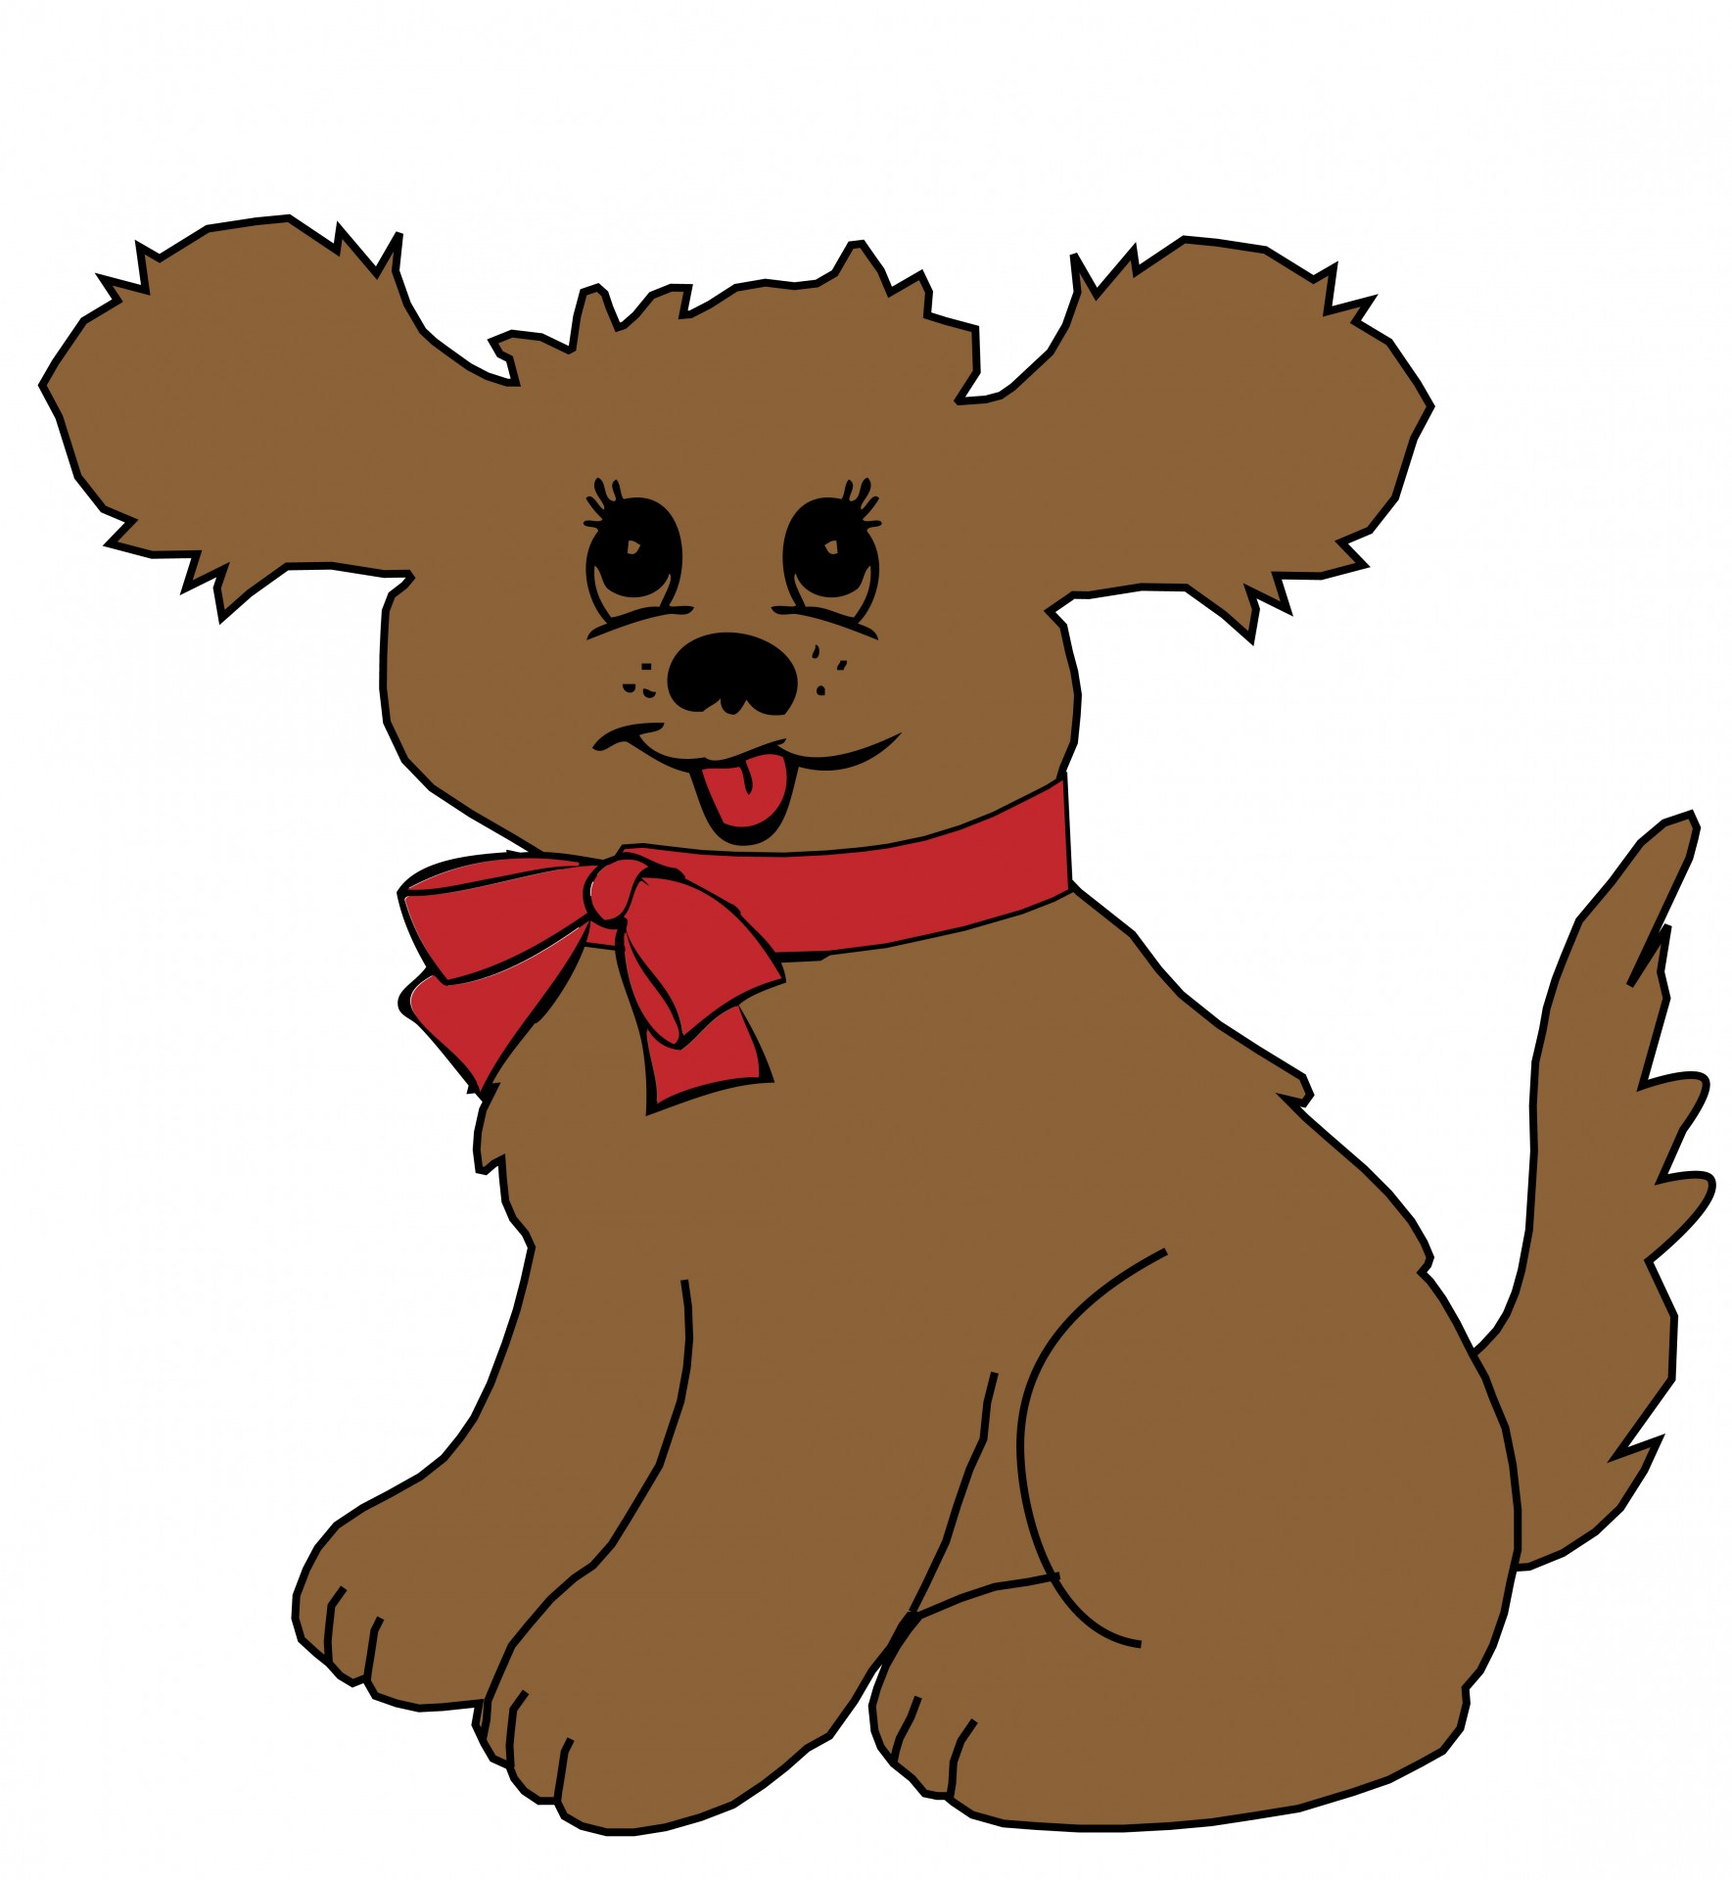

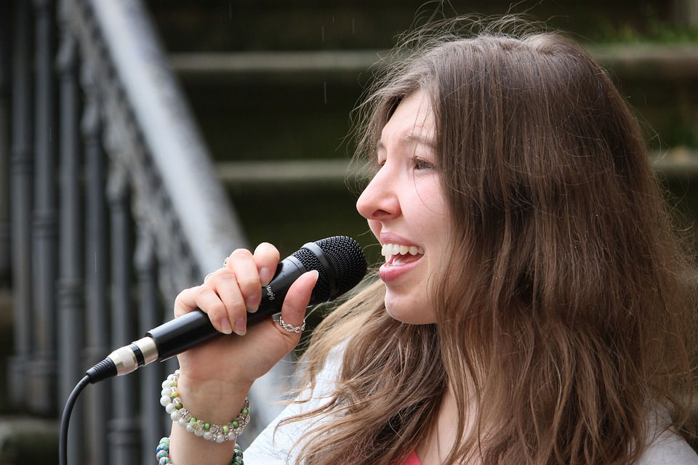
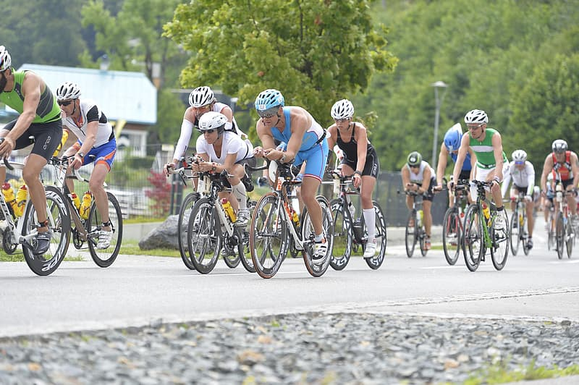
Punctuation continued
Commas- to separate items in a list.
I enjoy reading, singing and cycling.
The tiny, fluffy dog sniffed the flowers.
Notes:
1 min Action for comma- helps support children

Slide 14

Co-ordinating and subordinating connectives.
Co-ordinating conjunctions join two or more items of equal importance AND ARE OFTEN IN THE MIDDLE:
And : The children play tennis and they go to the park.
But: They can climb but they can’t swim.
Or: You can have mashed potato or you can have chips .
So: They got the highest score so they won the match.
Subordinating connectives (often introducing a subordinate clause that usually only makes sense next to the main clause)
When: We put our coats on when it rains.
If: I’ll help you if you like.
Because: I’m sad because it hurt.
That: I’d like a cake that has sparkles.
Notes:
5 mins
A lot of learning happens through teacher feedback- marking and verbal (symbols).
Make sentences using whiteboards- choose correct conjunction (use parents)

Slide 15
Tenses
Present | Past | Past progressive | Present progressive
He jumps. | We jumped. | They were jumping. | He is jumping.
I sleep. | They slept. | She was sleeping. | He is sleeping.
She paints. | You painted. | I was painting. | They are painting.
Notes:
2 mins Teach by comparison, acting, completng tables like this, lots of talking, reading and shared writing

Slide 16
Suffixes
Verb root word | -ing | -ed | -er
Hunt | hunting | hunted | hunter
jump | jumping | jumped | jumper
sit | sitting | sat | sitter
hike | hiking | hiked | hiker
Adjective root word | -er | -est
loud | louder | loudest
hot | hotter | hottest
happy | happier | happiest
nice | nicer | nicest
Notes:
2 mins Provide root words and suffixes to see which new words you can create
Mini tasks for early morning work, beginning of english lesson, during spelling session etc etc- repeat, repeat, repeat!

Slide 17
Suffixes cont’d
root word | -ment | -less | -ful | -ness | -ly
hope
enjoy
happy
cry | cries
carry | carries
Notes:
2 mins Can give ch a table like this to fill in.

Slide 18
Suffixes cont’d
root word | -ment | -less | -ful | -ness | -ly
hope |  | hopeless | hopeful
enjoy | enjoyment
happy |  |  |  | happiness | happily
cry | cries
carry | carries
Notes:
2 mins Can give ch a table like this to fill in.

Slide 19
Prefixes
root word | Un-
Happy | unhappy
lock | unlock
fair | unfair
Notes:
1 min
Saying opposite sentences with acting eg I am very happy vs I am very unhappy. etc

Slide 20
Expected standard for the
end of year 2
• write simple, coherent narratives about personal experiences and those of others (real or fictional)
• write about real events, recording these simply and clearly
• demarcate most sentences in their writing with capital letters and full stops, and use question marks correctly when required
• use present and past tense mostly correctly and consistently
• use co-ordination (e.g. or / and / but) and some subordination (e.g. when / if / that / because) to join clauses
• segment spoken words into phonemes and represent these by graphemes, spelling many of these words correctly and making phonically-plausible attempts at others
• spell many common exception words*
• form capital letters and digits of the correct size, orientation and relationship to one another and to lower-case letters
• use spacing between words that reflects the size of the letters.
Notes:
10-15 mins inc review
What the framework says. Look at samples of year 1 and year 2 work.

Slide 21

So, how can I support my child at home?
Use any opportunity to write for a purpose – Shopping list, birthday card etc.
When you are writing/typing/texting, ask your child to help you to remember which punctuation to use or how to spell etc.
Lots of opportunities for writing:
Post-it-notes
Notepad
whiteboard
Appealing pens
Ask your child to correct your writing for you (made up writing).
Spot the …. games when out with your child.
Spotting punctuation or grammar features when reading.
Use adverbs when cooking.
Adjectives to describe your surroundings.
Guess the verb acting games.
Orally telling stories/sentences.
Notes:
3 mins
Short and sweet and incidental learning is best. So child feels like the expert or doesn’t feel like they are learning.

Slide 22

Thank you for coming!
Any questions?

